Slide 1

International Council Meeting
June 10 – 14, 2024
Nairobi Kenya
Report of the Francophone West Africa Region
Pastor Urbain Ouedraogo

Slide 2
1. Personal Introduction (1 minute)
My name is Pastor Urban Kouka Ouedraogo. I come from Burkina Faso, a country geographically located in the heart of West Africa. I am married to one wife, father of 4 children and grandfather of 6 grandchildren.
Professionally, I worked in a bank in the past, before asking to voluntarily leave to devote myself more to the Lord's work, full-time.
At present, I am the titular pastor of a local church of the Assemblies of God and Director of the Missiological Institute of Francophone Africa (IMAF), formerly known as the Missiological Institute of the Sahel (IMS).
I thank God for his presence among us. And I say thank you to the people in charge of GlobeServe for the honour of speaking.
I am therefore going to present my report to you on behalf of the Francophone West Africa Region.

Slide 3
2. Presentation of hubs
Our region consists of 6 countries that I list here in alphabetical order. These are:
- Benin
-Burkina Faso
- Ivory Coast
- Guinea Conakry
-Mali
-Togo
In the near future, Niger could be a new field to explore. The action plans for the rest of 2024 will be presented to you in another chapter.

Slide 4
Events that took place in the early days of Globserve in the region, by nation
BENIN
The Exponential Disciple-Making Seminar, successfully held from September 19 to 23, 2022.
The training of trainers organized from March 08 to 09, 2024 in Lomé, in tandem with Togo.

Slide 5
BURKINA FASO
The Exponential Disciple-Making Seminar, successfully held from September 29 to 30, 2022.
The establishment of 4 Regional Representatives to cover the entire national territory.
The organization of 12 meetings of the hub committee, both face-to-face and online, from 2023 to the present.
The training of trainers organized from February 09 to 10, 2024.

Slide 6
CÔTE D’IVOIRE
Installation of the Globeserve Coordination of Côte d'Ivoire at the end of the exponential discipleship seminar, which was held from September 12 to 17, 2023 at the University of the Christian Alliance (UACA). Number of participants: 82 people. Members of the National Coordination Office: 8 people.
Training of Trainers Workshop, April 10 and 11, 2024. Number of participants: 12 participants. It was moderated by the facilitators Paul HARTFORD (USA) and Kasum BALBODE (Burkina Faso).
Training of trainers workshop on May 7 and 8, 2024 on zoom participants: 5 people.
Training seminar for missionaries and harvesters of the UEESO church in Daloa and Man from May 13 to 16, 2024. Participants: 36 in Daloa and 41 Man. Facilitator: Mrs. Angela IDOWU.

Slide 7
GUINÉE CONAKRY
From July 25 to 29, 2023, Exponential Disciple-Making Conference in Mamou. Number of participants: 70 people.
From 14 to 16 February 2024, Training of Missionary Formators Workshop in Conakry. Number of participants: 11 people.
August 1, 2023 to January 10, 2024: Identification of ethnic groups (research) that resulted in the adoption of the targets. The chosen peoples and their allies: Malinké, Pular and Soussou.
Our challenge is to contextualize missionary schools. Some formators who have been involved in the training of Bible school leaders are finding it difficult to change their (biblical) schools to mission schools.
Guinea has two schools, namely the Evangelical Center for Missionary Training (CEFOM), whose coordinator of the center is the director, and the missionary training center in Conakry.

Slide 8
MALI
The exponential disciple-making seminar, successfully organized from November 08 to 11, 2022.
Planning meeting in December 2022,
Distribution of Mali into zones,
Organized internal workshops for the training of regional representatives in December 2022.
Meeting of regional representatives, sharing of the GlobeServe vision and mobilization of stakeholders on February 07, 2023.
Training of trainers from 10 to 14 February 2024.

Slide 9
TOGO
The exponential seminar of the disciple-makers, successfully organized from August 29 to September 01, 2022.
The training of trainers from 08 to 09 March 2024 in tandem with Benin.
A meeting for the mobilization of the entire Body of Christ was envisaged but without success.
Generally speaking, and what is positive and for the whole Region, is that all these countries mentioned have expressed their desire to take part in the vision of GlobeServe.

Slide 10
3. Unreached Groups
While our research continues for reliable regional data, we present for information purposes the state of unreached peoples in Burkina Faso.
List of peoples not or very little involved among the unreached peoples:

Slide 11
List of peoples not or very little involved among the unreached peoples
1- Les Blé, 2- Les Bella 3- Les Bozo 4- Les Dioulas 5- Dogossè-fing 6- Hausa 7- Kalamsé | 8- Karaboro Ouest 9- Khepè 10- Khewa 11- Kpebo 12- Lohron 13- Pana 14- Rhimaïbé | 15- Samogho Diori 16- Samogho Dzuun 17- Samogho Gwan 18- Siamou 19- Sininké 20- Touareg | 21- Toussian Nord 22- Tienkan/Moami kan 23- Toussian Sud 24- Les Vique, 25- Les Wala 26- Zarma

Slide 12
Provisional list of non/least reached peoples of Burkina Faso by region
Cascade Region: | Les Blé, les Diori, les Dioula, les Dogossé fing, les Dogossé wilé, les Karaboro ouest, les Khepe, les Kpeeba, les Kéwa les Natioro, , les Sama-wara, les Sénoufo Niangolo, les Tiefo, les Turka.
Boucle du Mouhoun region: | Les Boso, les Somono, les Pana, les Kalemse, les marka, Les Miankan, les Nounouma.
Eastern Region: | Les Zarma, les Hausa, les Peuhl, les Berba/Biali
Centre-East Region: | Les Bissa Barka ,les Koussassé , les Moba, les Yana
Sahel Region: | Les Peuhl, les Kouroumba, les Songhaï, les Touareg, les Bella, les Peuhl Rhimaybé, les Zarma, les Hausa
South-West Region: | Les Dioula, les Dagara Lobr, les Dyan , les Kpadogo, les Puguli, les Lorhon ou Tembo, les Wala
Haut-Bassins region: | Les Bolon, les Bobo Dioula, les Dioula, les Sambla les Samogho dzuun, Les Samogo Gwan, les Senoufo Tagwa, Les Senoufo Nanerige, les Siamou, les ienkan/Moamikan, les Tiefo, les Toussian Nord, les Vigué
Central West Region: | Les Nuna, les Wala
Northern Region: | Les Kamboinsin, les Peuhl, les Yarse
Centre-North Region: | Les Sininke, les Silmimosse, les Yarse

Slide 13
Groups of people not reached (continued)
Peoples are adopted. Denominations have chosen to reach out to unreached peoples. The Assemblies of God (AD) for example have adopted the Vigués, the bolts, and many others.
The denominations organize prayers for these peoples. They send missionaries to proclaim the Good News to these unreached peoples.

Slide 14
4. The strength of the Church
In all 6 countries of the French-speaking West African region, the Church is strong not in its divisions but in its diversity. By way of illustration, we cite a few cases in which the unity of the Body of Christ is more and more manifest.
- In Mali, the Association of Evangelical Protestant Churches and Missions of Mali (AGEMPEM) and the Amen Réveil Federation are receptive to the vision of GlobeServe, with about fifteen denominations within them.
- In Burkina Faso, evangelicals are made up of 134 denominations divided into 4 federations including the oldest federation, the Federation of Evangelical Churches and Missions (FEME).
- In Benin, Côte d'Ivoire, Guinea and Togo, statistics on the composition of evangelicals are not yet within our reach.

Slide 15
The Strength of the Church (continued)
However, all these denominations work in synergy for the accomplishment of God's mission. All GlobeServe events are inclusive.
Today, every denomination recognizes the role of the church in relation to unreached peoples.
That being said, the level of commitment of the church can be seen through the adoption of the peoples not reached by the different denominations. No unreached people is neglected. Also, there is no denomination that is without a people adopted from within it.

Slide 16
5. Opportunities and challenges in the region
In the region, there are many significant opportunities for growth and awareness. These include:
The collaboration of the various federations that we talked about earlier.
The security crisis. It is not in itself a necessary evil. Rather, it constitutes a threat, even a mortal danger. But it is an opportunity for certain peoples, once inaccessible, to move and get closer to have access to the Gospel.

Slide 17
Opportunities and challenges in the region (continued)
Recent success stories or accomplishments that can serve as models for other regions:
1. Through the GlobeServe training, Pastor Moise SOW, also Regional Representative in the Cascades and Hauts-Bassin, is producing results on the ground. He learned the language and culture and currently speaks the language of the Vigué people well. He found a man of peace, and he began the Bible studies of discovery with them.
2. Pastor Philippe TRAORE has achieved feats in Seye and Gorlanie located 40 kilometers from Kourouma.
3. In Togo, the coordinator of the hub has done as many feats among the Kotokoli and the Kabiets and especially in Bafilo among a strongly Islamized population. Conversions are multiplying.

Slide 18
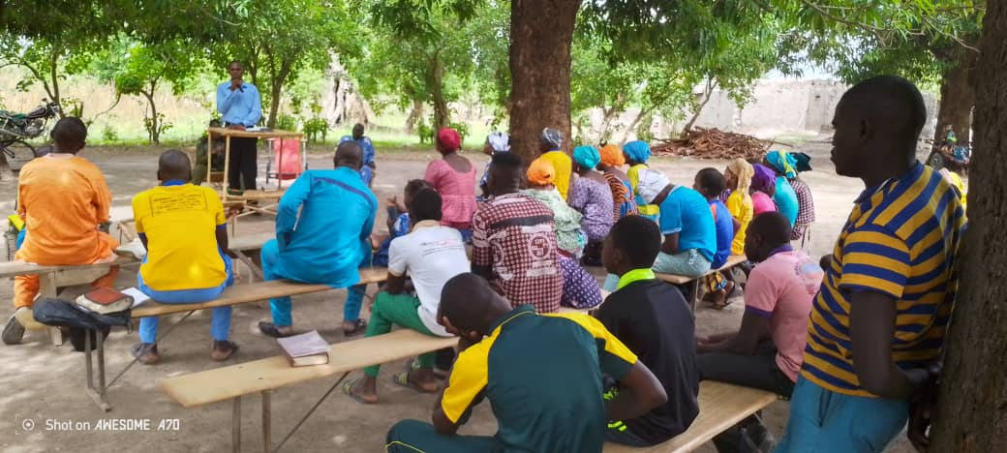
The Seye

Slide 19
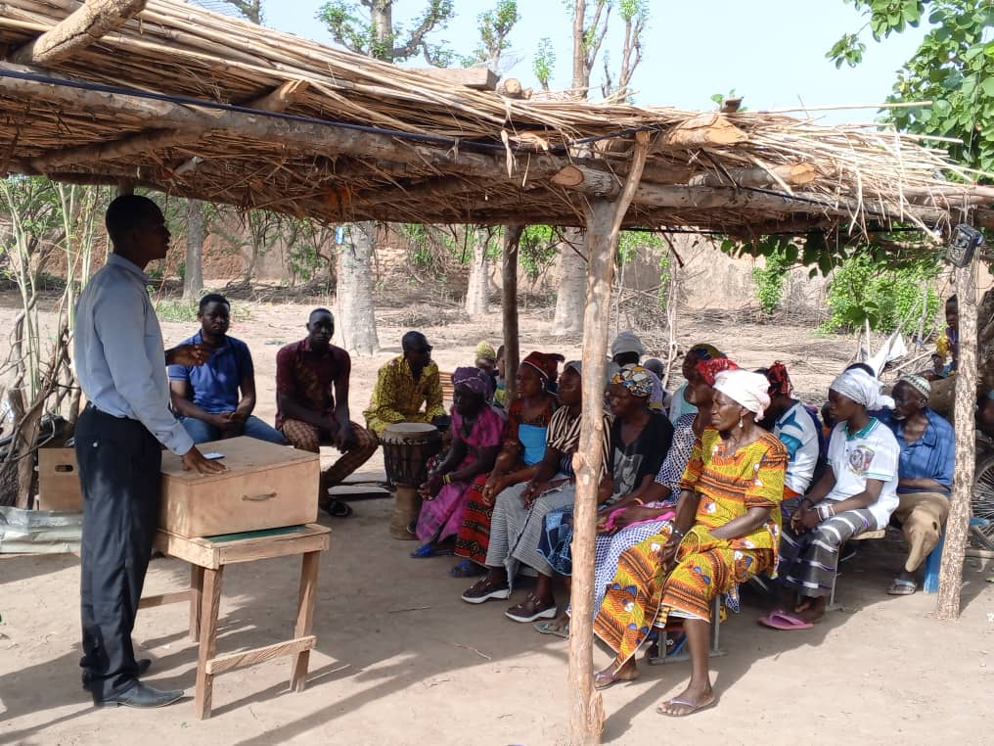
And Gorlan

Slide 20
Opportunities and challenges in the region (continued)
The main challenges facing churches and evangelistic programs are essentially about defining the right strategies. In all countries and in most denominations, goodwill is there. But the strategies used are often not the right ones. This is why we often see Pastors who are not trained to meet the missiological needs.
And the last straw is that they sometimes lack the humility to learn. While it is essential for the Church to develop new strategies to adapt to the current context.
However, some names send their elements for formation. This is why the training of these pastors occupies a good place in our various action plans.

Slide 21
Opportunities and challenges in the region (continued)
Socio-political, economic or cultural obstacles include insecurity. Terrorism and everything that can harm missionary work.
Access to internally displaced people is an opportunity to reach populations that were previously reluctant or who were in areas that were difficult to access.
But at the same time, we have to think about the basic needs of these people such as food, health and decent housing.
This means that we must think about mobilizing the resources necessary for their survival while we think about a holistic vision for the integral salvation of the human being.

Slide 22
6. Action Plan by Hubs and Prayer Points: BENIN
Actions | Objectives | Target audience | Timing and planning
In-person or online Committee meetings | Relancer les activités du comité et rendre l’équipe plus dynamique. | Les membres du bureau hubs | Juillet 2024 Septembre 2024 Novembre 2024
Organizing several Bible study sessions | Strengthening the capacities of actors | Representatives of the regions | 2nd half of 2024

Slide 23
Action plan by Hubs and prayer points: BURKINA FASO
Actions | Objectives | Target audience | Timing and planning
Online meeting of the Committee members | Statutory meeting | Committee Members | 09 July 2024
Meeting 1 of the members of the Hubs in person | Rencontre statutaire | The members of the Hubs among ourselves | July 23, 2024
Face-to-face meeting of regional managers | Training Missionaries in Discovery Bible Studies | The missionaries | July 23, 2024
Meeting 2 of the Hubs members with the participation of a representative of GlobeServe International | Statutory meeting | Hubs members and a representative from GlobeServe International | September 17, 2024

Slide 24
Action plan by Hubs and prayer points: BURKINA FASO (cont'd)
Training of Trainers Meeting | Strengthen the current team of trainers | The trainers | October 22 to 24, 2024
Organization of regional EDMs | Shaping and seeing progress with unreached peoples | Regional representatives in the zones of Bobo, Gaoua, Fada and Léo | From October 29 to November 15, 2024
Recycling on GlobeServe's Vision | Organize Discovery Bible Study Sessions

Slide 25
Action Plan by Hubs and Prayer Points: IVORY COAST
Actions | Objectives | Target audience | Timing and planning
Mission Visits | Engaging school leaders | National Mission School Leaders | July 2024 to September 2024
Mission Visits. | Organize capacity-building workshops for missionaries upon request | Missionaries in their mission fields | Western Region (August-September 2024). Northern Region (January-March 2025). Centre Region (May-June 2025).

Slide 26
Action Plan by Hubs and Prayer Points: GUINEA CONAKRY
Actions | Objectives | Target audience | Timing and planning
Face-to-face meetings | Capacity building | Members of the Guinea hubs | October 2024
Contextualizing Bible Schools | Work to contextualize at least 2 Bible schools into mission schools | Bible School Leaders Who Participated in the AFM | During 2024-2025
Missionary Formation at CEFOM | Solidifying ownership of GlobeServe's vision | The Pastors | From 29 July to 31 August 2024 in Kankan

Slide 27
Plan d’actions par Hubs et points de prière : MALI
Actions | Objectives | Target audience | Timing and planning
Launch of a series of surveys | To be able to reach the areas that have not received the Gospel and to plan the deployment of human resources for the mission within them | The Christian or non-present or not present by village, the villages with or without Church by commune | 2nd half of 2024
Deployment of new waves of missionaries | Evangelize and plant churches in villages without Christians or without churches | Unreached peoples | Year 2025

Slide 28
Plan d’actions par Hubs et points de prière : TOGO
Actions | Objectives | Target audience | Timing and planning
Evangelization | Convert 3000 Muslims | The Muslim population | Before the end of 2026
Mission Visits | Encouraging and Supporting Missionaries | The missionaries and the Kébou and Pagala peoples | During the year 2024
Implantation d’Eglises | Planting a Church for a Village among the Kebu People | Kebou people | 2027 to 2028
Conferences | Organize a conference in the far north of Togo | Mobilizing Pastors | November 2024

Slide 29
Prayer Points by Country
BENIN: Pray for the motivation of the members of the hubs committee.
BURKINA FASO: Pray for peace in Burkina Faso and sub-Saharan African countries that suffer from terrorism.
IVORY COAST: Prayer points: Pray for the motivation and availability of the members of the office or the replacement of some by other members. Pray for the financial needs of 3,800,000 FCFA for the financing of these actions.
CONAKRY GUINEA: Give thanks for the assumption of the cost of the training by the beneficiaries and partner churches. Pray for support in travel and accommodation costs for the coordination meeting.
MALI: Pray for the success of the planned investigations.
TOGO: Pray about financial challenges. The precariousness of financial means, the lack of decent housing and logistics in general, negatively influenced the missionaries' impetus.

Slide 30
7. Conclusion
To conclude, we note that according to the achievements of each Hub presented, the foundations are established, for a good evolution of GlobeServe, up to the expectations expressed.
We have been able to see the effectiveness of the presence of unreached peoples in the nations of our region. For the accomplishment of the mission in favor of these peoples, the Church needs to be strong.
Glory be to God for this, because in every nation there is a Church strong in its diversity and not in its divisions. In all six (6) States, for example, the GlobeServe appeal is being answered inclusively, showing that the concept of the unity of the Body of Christ is becoming more and more understood. And even when insecurity is rife, opportunities for evangelization remain.

