Slide 1
GlobeServe Resources
Missionary Training Resource Team

Slide 2
The purpose of the GlobeServe Missionary Training Resource Team is to facilitate the development of training initiatives which are focused on training missionaries to see disciple-making movements established among unreached people groups, and to facilitate excellence and collaboration among GlobeServe members involved in training.

Slide 3
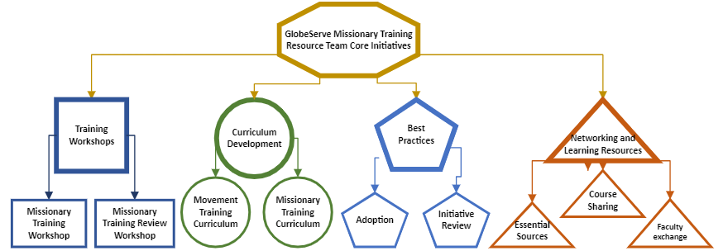
Notes:
There are four key initiatives of the GlobeServe Missionary Training Resource Team are shown in the chart below and explained as follows

Slide 4
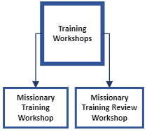
Notes:
Training Workshops.
To develop and conduct training workshops and consultations that serve to build training initiatives within GlobeServe which work toward the establishment of church planting movements among unreached people groups.
This category has room for expansion. Currently the only active initiative here is the Missionary Training Workshop.
Missionary Training Workshop – This staple Workshop of GlobeServe has been redeployed in a new format and is being evaluated with improvements to be made across Central and West Africa. There is an opportunity now to bring this training beyond to the entire GlobeServe body as needed.
Missionary Training Review Workshop – This is still in concept form, but there is a great likelihood that some Hubs within GlobeServe might benefit from a review workshop to re-engage/kickstart missionary training. Other existing schools might benefit from a refresher on the components.
A test project is being developed to place the MTW workshop into an online course format for use after the live seminar.

Slide 5
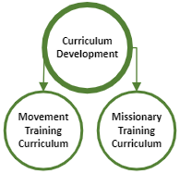
Notes:
Curriculum Development
To develop relevant and highly contextualizable curricula for use and modification as needed by GlobeServe partner training initiatives.
Building off past successes and some of the work of John Kayser and others, GlobeServe is positioned to begin a strong global sharing of curriculum resources.
This category also has room for expansion.
Missionary Training Curriculum – This started with a Bethany International initiative to develop packaged courses on key subjects of missionary training which could be used by GlobeServe partners. This can be expanded greatly with contributions of successful courses from GlobeServe partners. To be useable, courses must be designed in such a way as to be contextually adjustable as needed by the partner using them.
Movement Training Curriculum – We have wondered as a team if there would be a separate stream of movement-oriented curriculum to train missionary school leaders and faculty to think and teach more from a movement perspective. This has not yet been developed.

Slide 6
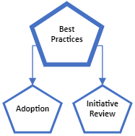
Notes:
Implementation of Standards of Best Practices
To broadly disseminate and encourage the adoption and implementation of the GlobeServe Standards of Best Practices in Missionary Training.
The GlobeServe Standards of Best Practices were developed and approved by the GlobeServe council early in 2023. Now broad dissemination is needed with two main objectives:
Adoption. With hundreds of large and small training initiatives engaged in GlobeServe, raising awareness of the Standards, and encouraging adoption of and alignment with the Standards is now a strong need.
Initiative Review – The Standards are designed with the idea that they would become a basis for a process of peer review between training initiatives. As the GTI team grows there will be opportunities to train regional representatives to begin scheduling and prototyping this process.

Slide 7
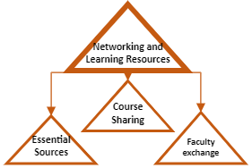
Notes:
Networking and Learning Resources
To promote collaboration in the sharing of learning resources between GlobeServe partner training initiatives.
In alignment with the idea of Curriculum Development, we believe that a growing GlobeServe has an opportunity for a higher level of sharing of learning resources between members around the world. This would include:
Sharing of course outlines, materials, syllabi, and concepts – Existing GlobeServe partner schools have done a lot of the work of designing excellent missionary training for their own context. Newer partner schools can benefit from this expertise if GlobeServe can develop a platform for sharing and dissemination where materials and ideas can be made available to schools throughout the GS family for use and modification within their own context.
Faculty Exchange – Many GlobeServe schools have benefited greatly from visiting faculty, especially in the early days of a school when there is no one available in the context to teach certain topics. Especially regionally, we could encourage stronger schools to allow some of their teachers to teach in other GlobeServe schools. Hubs would need to work out the management of the costs involved.
Essential Sources – this is a concept still. The idea would be to take core resources on missions, movements, ecclesiology, anthropology, etc. and write Easy English concept papers on these topics, citing the core resources. This would result in a non-copyrighted (or our own copyright) document which could be placed in a compendium/reader for various courses. This would be a lot of work, but we could commission it from various missionaries, teachers, and leaders, or even graduate level students.

Slide 8
Team Composition
The current team consists of
Paul Hartford
Segun Adekoya
Sunday Ajibade
Recently added representatives from Francophone Africa:
Kassum Balbone – West Francophone Africa
Lazare Naida – Central Francophone Africa
We need to identify new representatives for this team from
Southeast Asia
South Asia
Indonesia
East Africa
Latin America
Notes:
With the team growth, the team would eventually choose a core team to lead the wider team.
To introduce these two:
Kassum
Cross cultural Missions training in Nigeria CAPRO School of Missions in Jos
Sociology and Anthropology studies at the University of Ouagadougou Burkina Faso
Additional studies on missions mobilization in Thailand with Students Volunteers movement (SVM2
Leadership and organization management with Development Associates International (DAI).
Ivolved in cross cultural missions with CAPRO since 2004 in Nigeria, 2006 in Burkina and became the
National Coordinator for CAPRO Burkina since 2011 till the end of this year
National representative for Global recordings in Burkina Faso since 2011
Teaching Missions in theological and missions schools in Burkina (IMAF, Baptist school in Diebougou in Burkina, FEME University...) - I am also a facilitator for some missions organizations or schools like: DAI, Al Massira, and now Globserve
Author of 3 books on missions in French as well as co-author of two others.
100 years of evangelism in Burkina, missionary analysis;
Crosscultural Missions: make disciples of all nations
Principles-strategies-steps in church planting among the Unreached
Lazare
University degrees
1. BA in bilingual studies, 1984, translation as option from the university of yaoundé (cameroon) and the university of east anglia (norwich, uk);
2. Maitrise de linguistique et langues africaines, 1985, university of yaounde ;
3. Ma in applied linguistics (diploma of translation), buea university, 1987. 4.
Certificate of christian leadership & evangelism, singapore, 1996.
5. Certificate of partnership ministry and training of trainers.
6. Certificate of christian brodcasting, yaounde.
7. Certificate of training pastors and christian leaders, douala, cfbp.
8. Ph d theology cornerstone seminary, 2012
His previous background was as a linguist, including senior translator for the Ministry of Commercial and Induistrial Development of Cameroon
He currently serves as Hub coordinator for Cameroon, and as regional coordinator for central francophone Africa for OCC and national director for Cameroon of EHC as well as several other ministry involvements.

Slide 9
Team Qualifications
A member in good standing of a GlobeServe Hub
Significant intercultural ministry experience
Significant experience as a trainer
Significant training as a trainer
Committed to GlobeServe principles, practices, and goals
Ability to travel
Willingness of organization to release time for travel

Slide 10
2023-2024 Accomplishments
November
Sierra Leone and Liberia Follow-up and Gambia MTW
Paul
December
MTW in Cameroon, CAR, Congo, DRC
Paul and Lazare
January
MTW in Burkina Faso, Mali, Guinea Conakry
Segun and Kassum
MTW in Rwanda and Burundi
Paul and Lazare
MTW in Togo, Benin, and Coté d’Ivoire
Paul and Kassum
February/March
April

Slide 11
The Training Team is successful if the following outcomes are realized:
New missionary training initiatives are started among partners
Existing missionary training initiatives are strengthened
Training resources are collected and shared
Training initiatives collaborate more
New missionaries are trained and fielded as a result of these activities.

