Slide 1
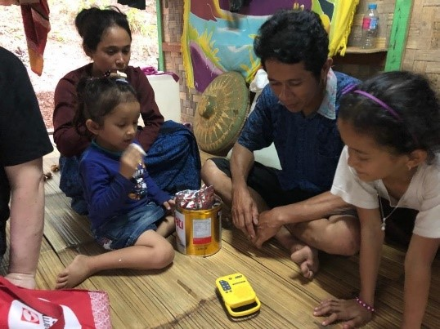
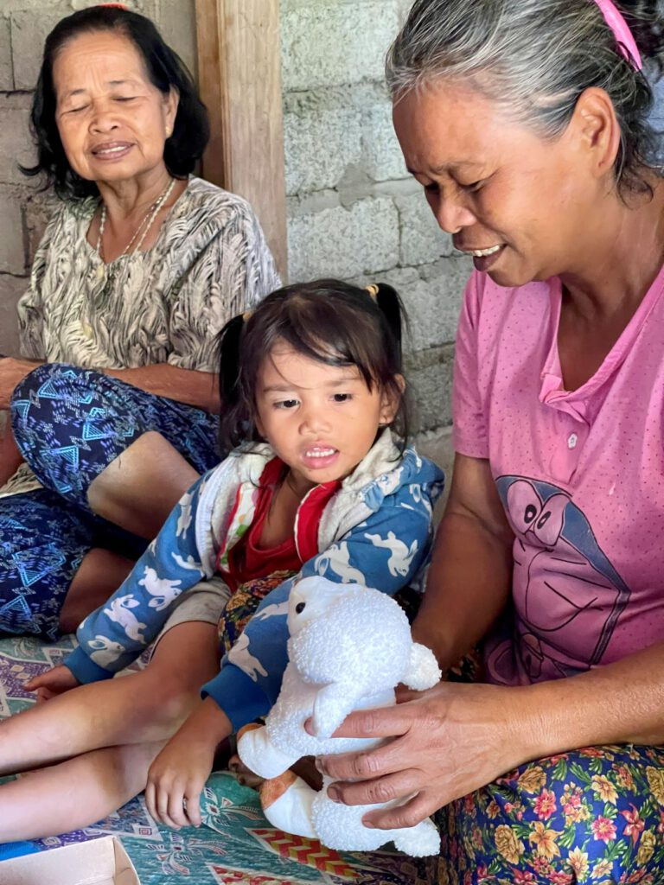
KULUMI PRESENTATION
KENYA 2024
WRITTEN BY CAROL AND PREPARED BY SAM DUNYA

Slide 2
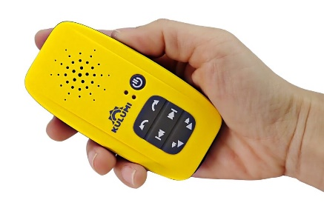
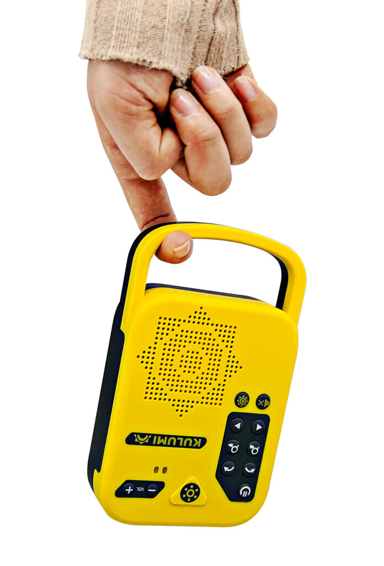
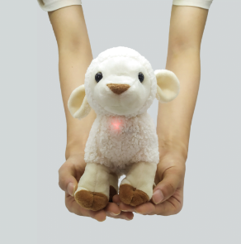
KULUMI – About the 3 Devices made by Kulumi:
A pocket-size “X” comes in Yellow
and Blue – for sensitive locations
The Sheep being tactile, is powerful for children, the abused, traumatized, elderly, bedridden.
MINI
This has a FLASHLIGHT, POWER BANK and RADIO

Slide 3
Open your 2 Devices
A small piece of paper inside your box lists the contents of each of your customized devices. Carol Freeman will also send a screen shot of it to you by WhatsApp. Save it there for easy reference.
Another little piece of paper inside your box is entitled, ‘Navigation Tools’. Use that ‘cheat sheet’ to master navigating to your spot in the Bible. The tools are different between the sheep and the other two devices.
You will also find charging cable/s in your boxes.

Slide 4
NAVIGATING THE KULUMI POCKET X
Long press on/off button. Light comes on.
Top row contains the Root Folders where you navigate between languages/testaments/Bible stories, pressing the forward/reverse buttons. The Content paper enclosed in your box only contains the titles of the Root folders.
Middle row contains the Sub-Folders where you navigate between the books of the Bible, or if you are in a Bible Story Root Folder, then you navigate between the sets of stories in that same language. (This is not listed on your ‘Content’ paper, but if you attach your green cord to the device and to your laptop, you can click on any root folder and see what it contains in its sub-folder.)
Bottom row contains the Files where you navigate to the chapters or individual stories in that language. (This is also not listed on your ‘Content’ paper, but with your green cord connected to the device and to your laptop, you can double-click on any root folder, then double-click on the sub-folder and see what files are contained in the sub-folder.)
Bottom row also goes high-speed when you give it a long press, forward or reverse, so you can more quickly get to the chapter of your choice.
The Pocket X is water-resistant. It can handle a little rain but don’t
submerge it in water.
on/
off
Root Folders
Sub-folders
Fast-forward
Files

Slide 5
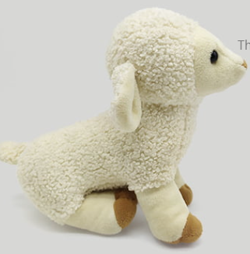
NAVIGATING THE KULUMI SHEEP
Long press on the nose to turn it on. The sheep will play for 5-8 hours.
The back feet of the Sheep are Folders to navigate forward/reverse between the books of the Bible, or if you are in a Bible Story Set, then click them to navigate between the sets of stories. Its left feet when facing you, click in reverse, right feet navigate forward. Click the feet!
The front feet are Files where you navigate the chapters of the Bible book or individual stories of the Bible Story Set that you are in. (These stories are not listed on your ‘Content’ paper, but if you attach your green cord to the device and to your laptop, you can double-click on any folder and see what stories they contain.)
If you long-press on either of the front feet, the volume will increase. If you long-press on either of the back feet, the volume will decrease.
The sheep is washable. Open the zipper and gently detach the battery from the wires. You can now wash the sheep in the washing machine including the wires, but do not get the battery wet. Allow the sheep to dry thoroughly before re-attaching.
After half an hour of inactivity, the sheep will turn off automatically.
A short click of the on/off button of the Sheep’s nose will make it blink and pause your device. Short click to un-pause. Long press for on/off.
Because there are less navigation tools on a Sheep (only 4 feet vs. 6 buttons), it is recommended to keep the Sheep to just one language, as there are no ‘Root’ folders in it.

Slide 6
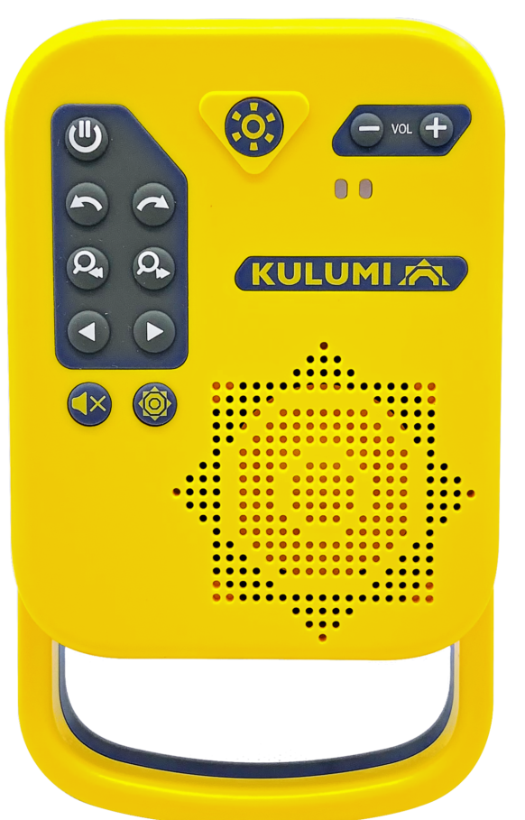
NAVIGATING THE KULUMI MINI
on/
off
Long press on/off button. Light comes on.
Top row contains the Root Folders where you navigate between languages/testaments/Bible stories, pressing the forward/reverse buttons.
Middle row contains the Sub-Folders where you navigate between the books of the Bible, or if you are in a Bible Story Root Folder, then you navigate between the sets of stories in that same language. (If you attach your green cord to the device and to your laptop, you can click on any root folder and see what it contains in its sub-folder.) Middle Arrows when used in radio mode will search for FM radio channels. (Antenna enclosed in box. Connect to red side port as a speaker.)
Bottom row contains the Files where you navigate the chapters or individual stories in that language. (With your green cord connected to the device and to your laptop, you can double-click on any root folder, then double-click on the sub-folder and see what files are contained in the sub-folder.)
Bottom row also goes high-speed when you give it a long press, forward or reverse, so you can more quickly get to the chapter of your choice.
The Mini is not waterproof. Avoid water.
Root Folders
Sub-folders
Radio search
Files
Radio on/off

Slide 7
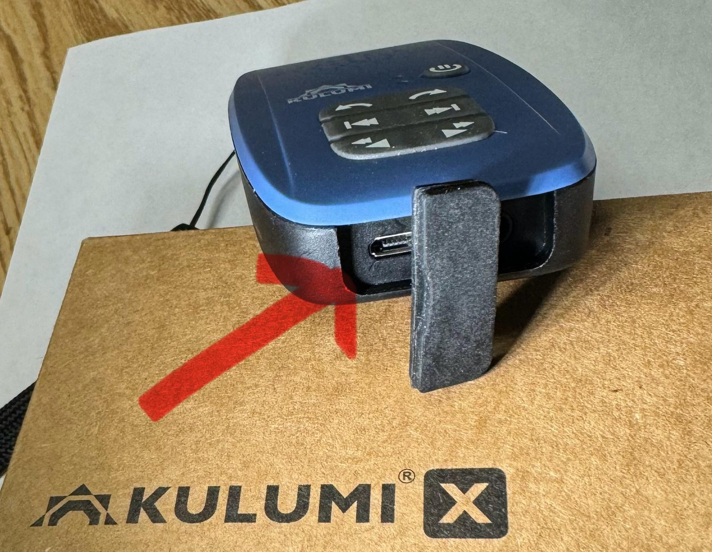
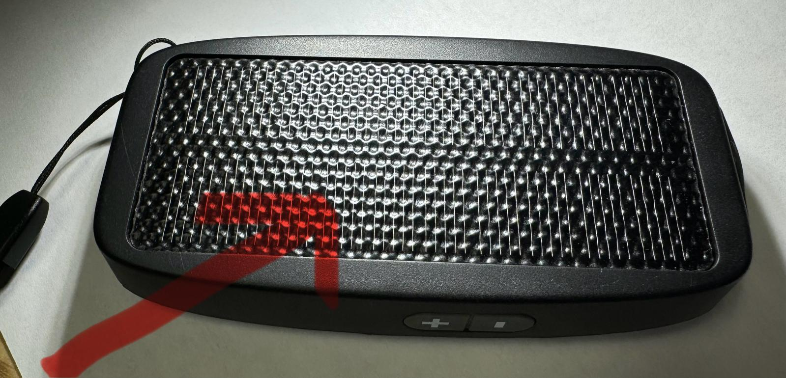
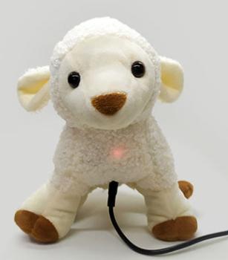
CHARGING YOUR DEVICE:
Solar Panel
The Pocket X and Mini can be charged with solar power from flat to full in 10-12 hours by placing your device solar panel up towards direct sunlight.
If you use the charging cable, insert it into the port hidden under the foam cover at the bottom of the X or on the side of the Mini.
The Sheep can only be charged with a charging cable. It has no solar power and no ear jack. Unzip the stomach and plug in the cable to the port.

Slide 8
BLACK CABLE:
Use this to recharge your device in 2-5 hours. If you lose this, it is easily replaced at any computer store inexpensively. This black cable only comes with the Pocket X and Mini, not with the sheep.

Slide 9
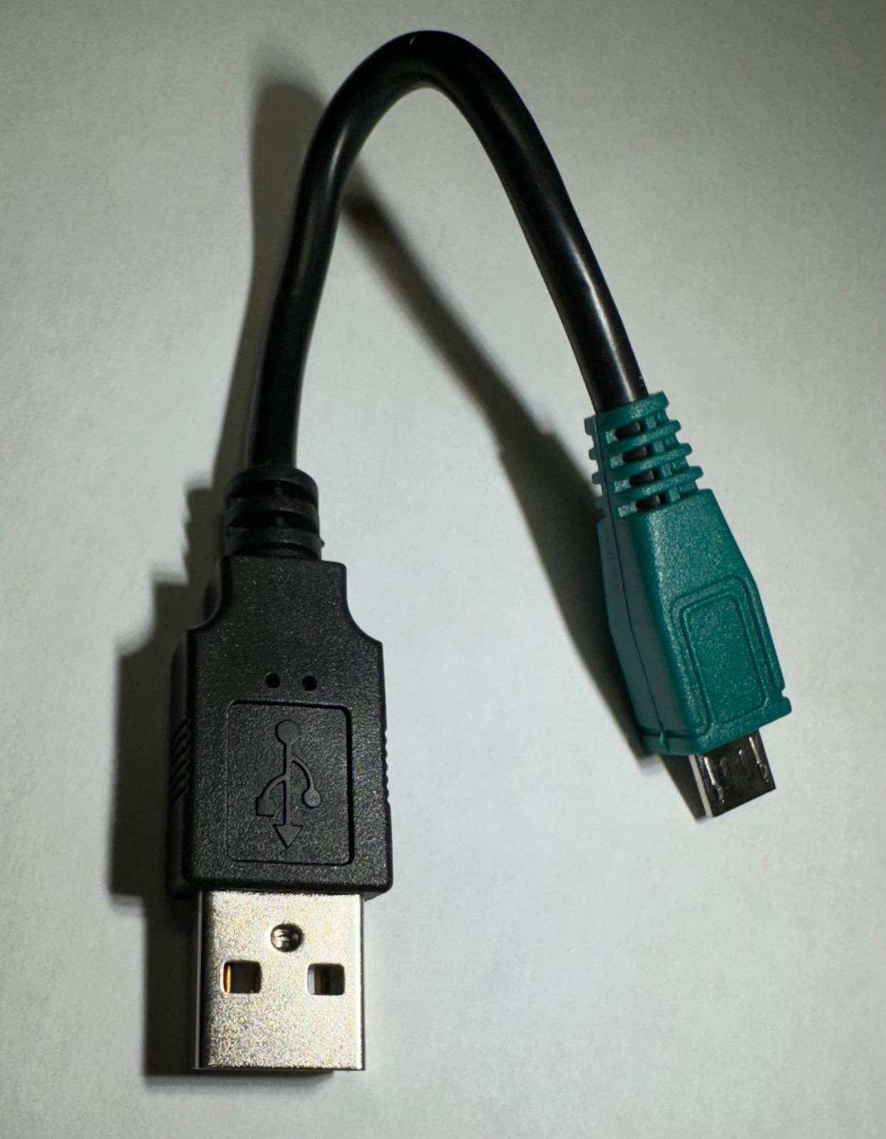
GREEN-ENDED CABLE
Keep this green-ended cable in a safe place, perhaps with your IT person. It is proprietary to Kulumi.
It can be used for charging any Kulumi device, but its main purpose is to connect with your laptop for you to see and edit its content. If it gets lost, you will not be able to view the content without ordering a new one from Kulumi for $1 + shipping.
Recommended that you charge the devices with a non-proprietary black cord, which is inexpensively replaceable anywhere. Or you can charge using solar power.

Slide 10
Kulumi CARE
Don’t let your device die before you re-charge. Devices can be slow to rise from the dead but should revive when given a long recharge.
Best Practice is to charge your devices when you get back to your room today and to always charge them when:
Sheep: you hear it say, ‘Low battery, please charge.’ (The sheep’s light is always red when it is playing. It does not mean that it is low battery.)
Pocket X and Mini Flashlight: The red light will turn green when it is fully charged.
When a device is fully charged, it can remain in storage for more than 1 year.
All Kulumi devices are guaranteed for 2 years from date of purchase.

Slide 11
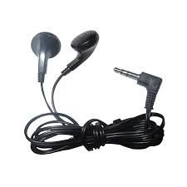
Earphones:
Donated earphones are in each Pocket X device. Look for the earphone jack under the foam cover. Any simple earphone will work fine in the X and Mini.
If you order more Kulumis, they will NOT come with earphones.

Slide 12
PROGRAMMING THE PLAYER:
Deleting – just attach device to your laptop, go to the drive, click on the file and click delete
Adding Custom Content – this is more complicated. Follow the instructions at https://kulumi.org/program/ Only .mp3 files can be used in a Kulumi.
For 2000 more New and Old Testaments, go to: https://www.faithcomesbyhearing.com/audio-bible-resources/mp3-downloads
For 6000 more Bible stories from Creation to Christ, go to: https://globalrecordings.net/en/search/language
All Kulumi devices have 8GB memory and are guaranteed for 2 years from date of purchase.

Slide 13
KULUMI HUB LOCATIONS & Managers If you want to order more devices, please go to https://kulumi.org/contact/ to submit your order. They will take your payment online and connect you with your closest Kulumi Hub for any programming and delivery.
Nigeria, Jos (Atamang Luka)
Kenya, Nairobi (Helen Etyang)
Sierra Leone, Freetown (Gabriel Harrera)
South Africa, Vanderbijlpark (Gabi Hendrich)
Thailand, Satun (Julie Ah Sen)
Indonesia, Bali (Clive Gray)
Philippines, Baguio City (Ghie Salicsic)
Nepal, Kathmandu (Tanka Subedi)
Mexico, Oaxaca (Diego Guttierez)
USA, Minnesota (Carol Freeman)
UK, Northern Ireland (Robert Davidson)
UK, Scotland (Kenny McKee)
France, Sisteron (Sam Bouix)
Coming Soon:
Ghana Accra (Sam Dunya, Jr)
India, Aurangabad (Cecil Shrisunder)
Pakistan, Lahore (Salas Rashid)

Slide 14
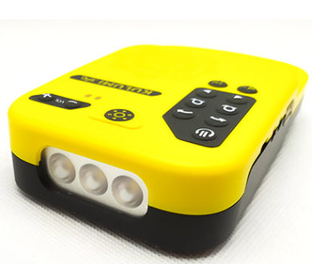
Kulumi Costs: These are Kulumi products’ approximate prices at the hubs in USD. (Includes international shipping from our factory to the hub, custom duties, and VAT. Excludes local delivery in-country). Add $1 per device for the Kulumi Hub team to program your devices. Due to higher custom duties, prices are $1 to $2 higher per device in South Africa and Europe.
$25 USD
$12 USD
$22 USD

Slide 15
Let us pray over your Kulumis!
I have prayed over your Kulumis as I loaded:
95 Bibles and
89 Creation to Christ story sets in
your 115 languages
I pray that all these devices will end up in the hands of those whose hearts are good soil and will bear much fruit.
That they will be open to you, open to your message of the Kingdom and open to Jesus, the hope of the world!

