Slide 1
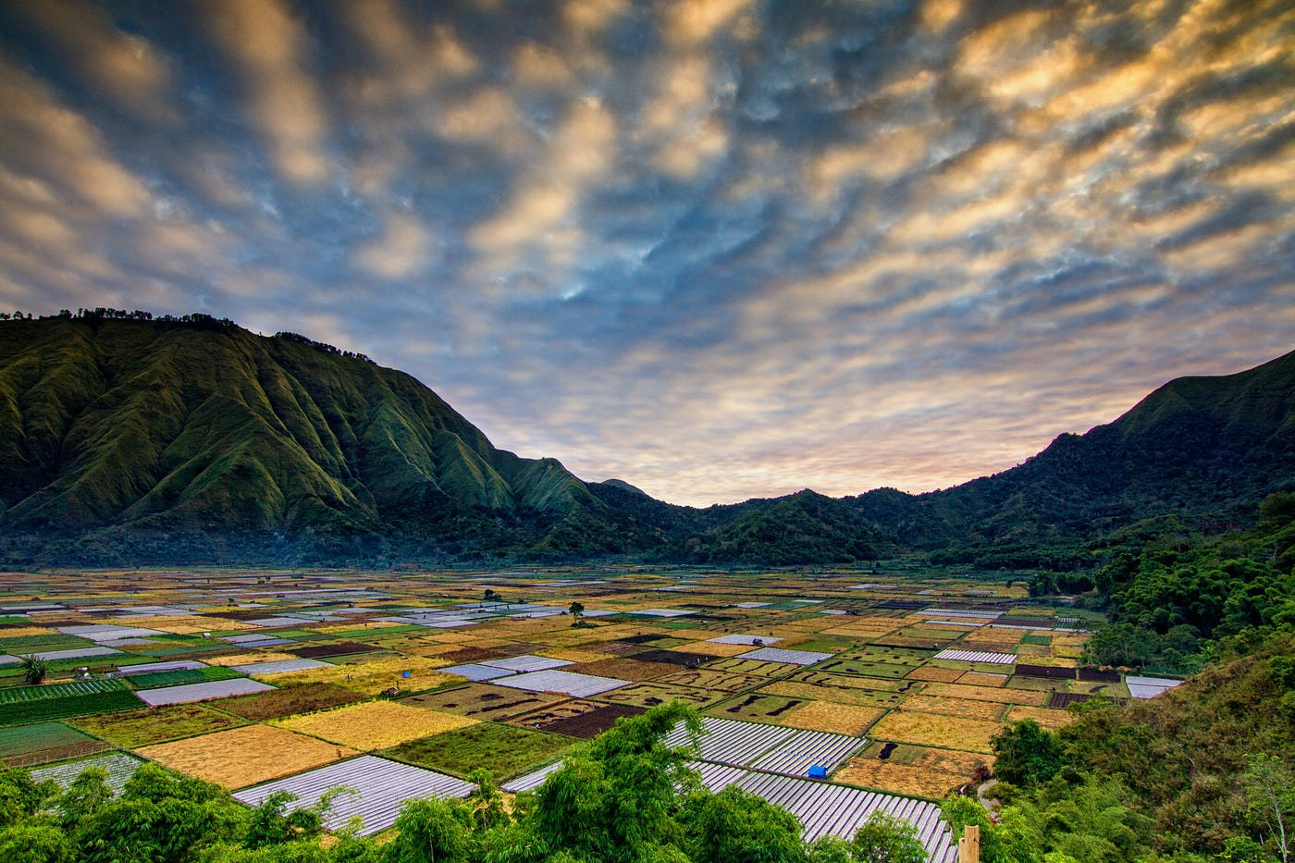
Indonesia
Regional Coordinator Reports

Slide 2
Indonesia hub
“mission”
“A collaborative mission work dedicated to equipping and empowering individuals to reach the unreached people groups in Indonesia with the message of Christ and plant churches among them. To train and disciple new believers to become effective evangelists within their own communities, ultimately bringing as many people to Christ and nurturing them to reach others. our desire is to see multiplication movement among the upgs in Indonesia”

Slide 3
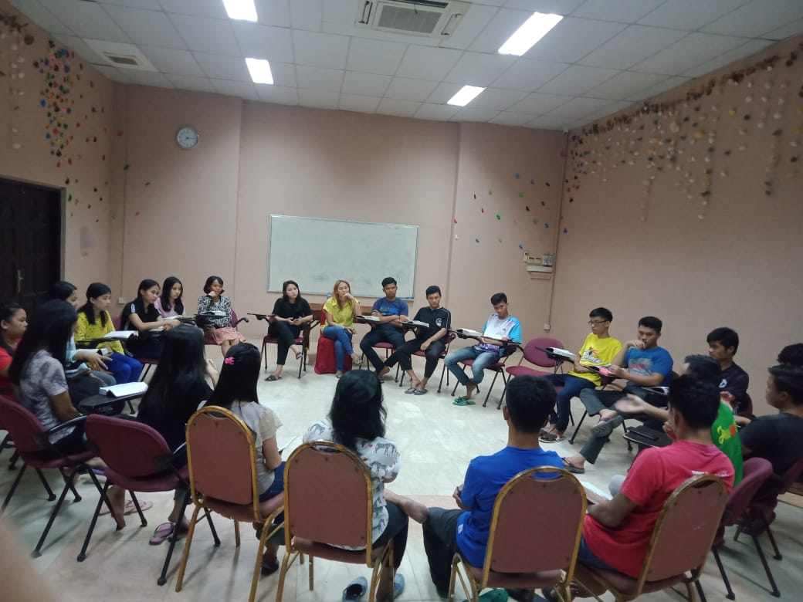
Focus areas
Training and equipping
“Providing comprehensive training programs to equip individuals with the Bible knowledge, skills, and tools needed to effectively share the Gospel in unreached areas.”
3

Slide 4
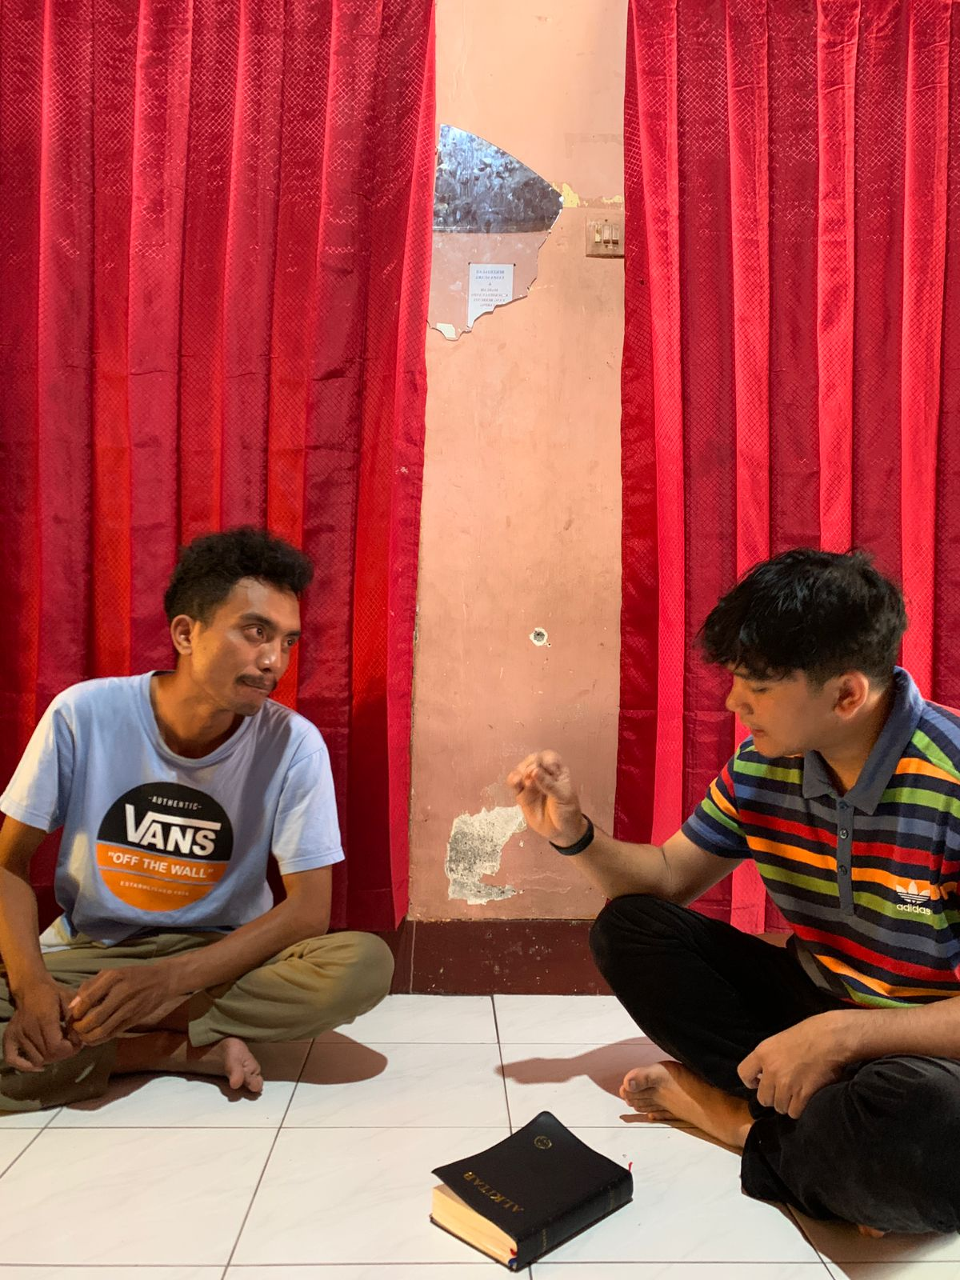
Focus areas
Discipleship
“Fostering a culture of discipleship to help believers grow in their faith, knowledge of scripture, and ability to disciple others within their community.”
3

Slide 5
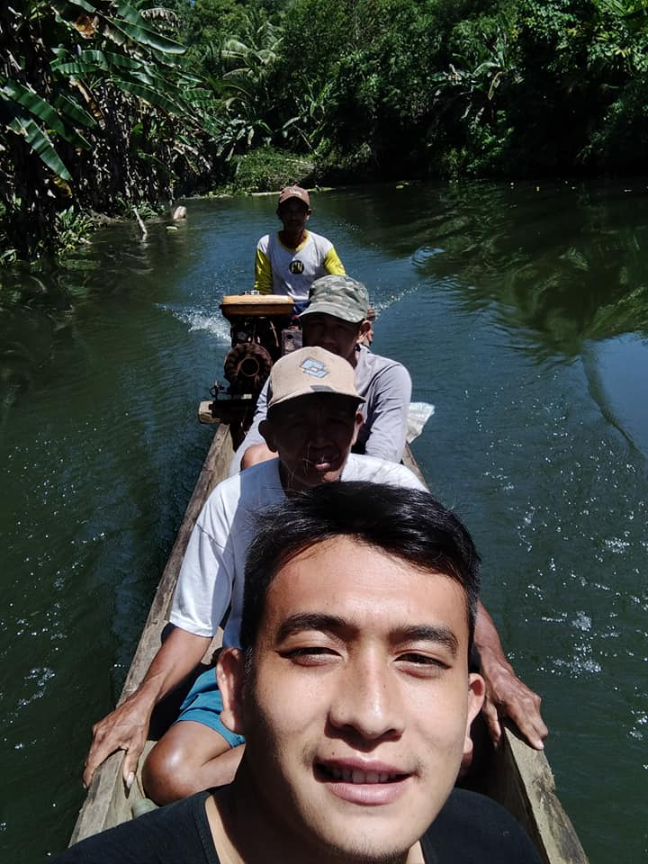
Focus areas
Unreached People group
“Targeting unreached people groups in Indonesia with a focus on contextually relevant evangelism strategies.”
3

Slide 6
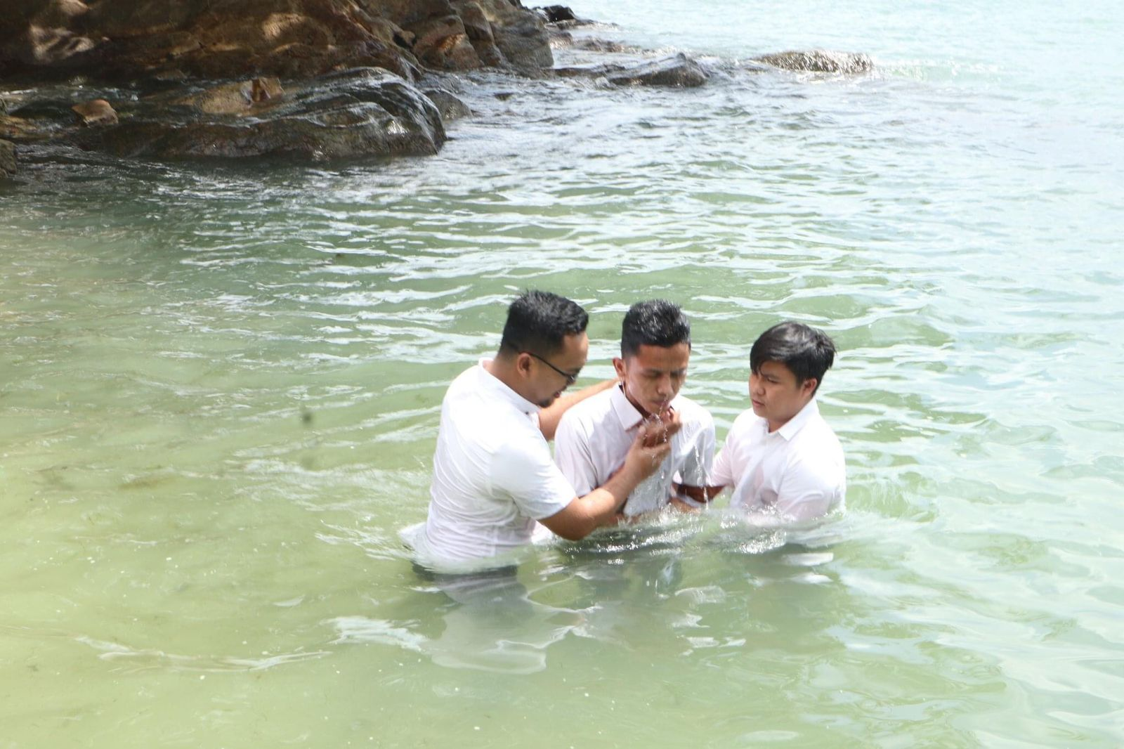
Focus areas
Multiplication
“Empowering believers to multiply their impact by training them to disciple others.”
3

Slide 7
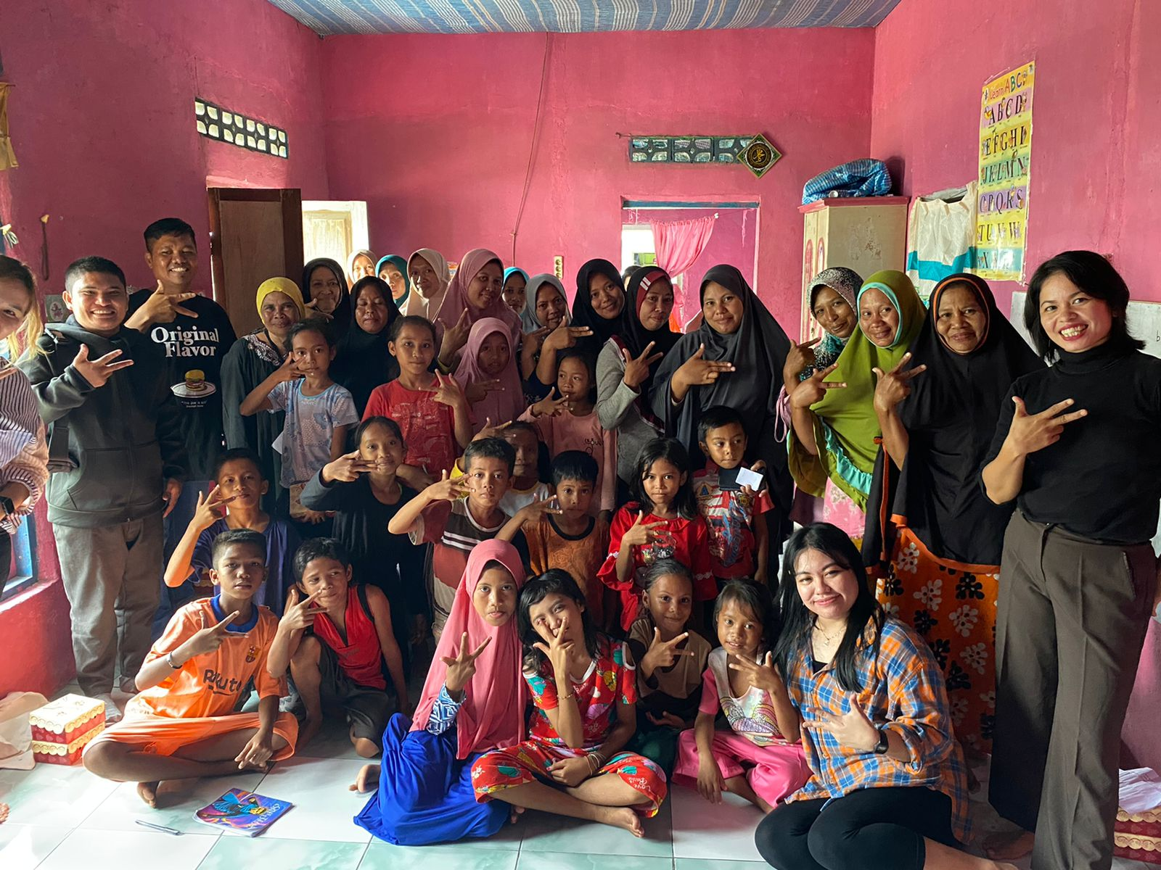
Focus areas
Community engagement
“Engaging with the local communities, building relationships, and addressing their spiritual and practical needs through Christ-centered initiatives.”
3

Slide 8
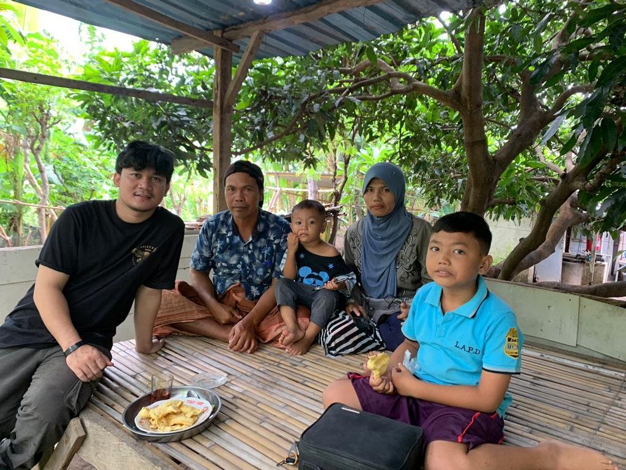
ROLE AND IMPACT
IN REGIONAL OUTREACH
INDONESIA HUB
“Through Indonesia hub members’ efforts, we have been able to send missionaries to unreached people groups across Indonesia last year, transforming lives, and sharing the Gospel and many to those who heard the Gospel for the first time in their lives.”

Slide 9
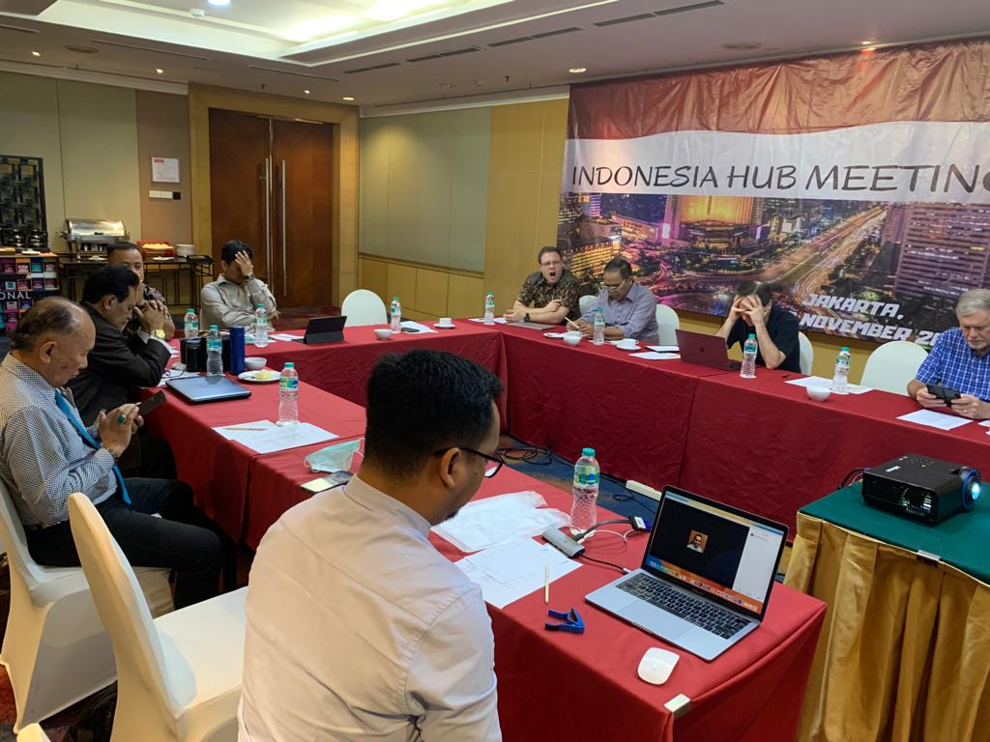
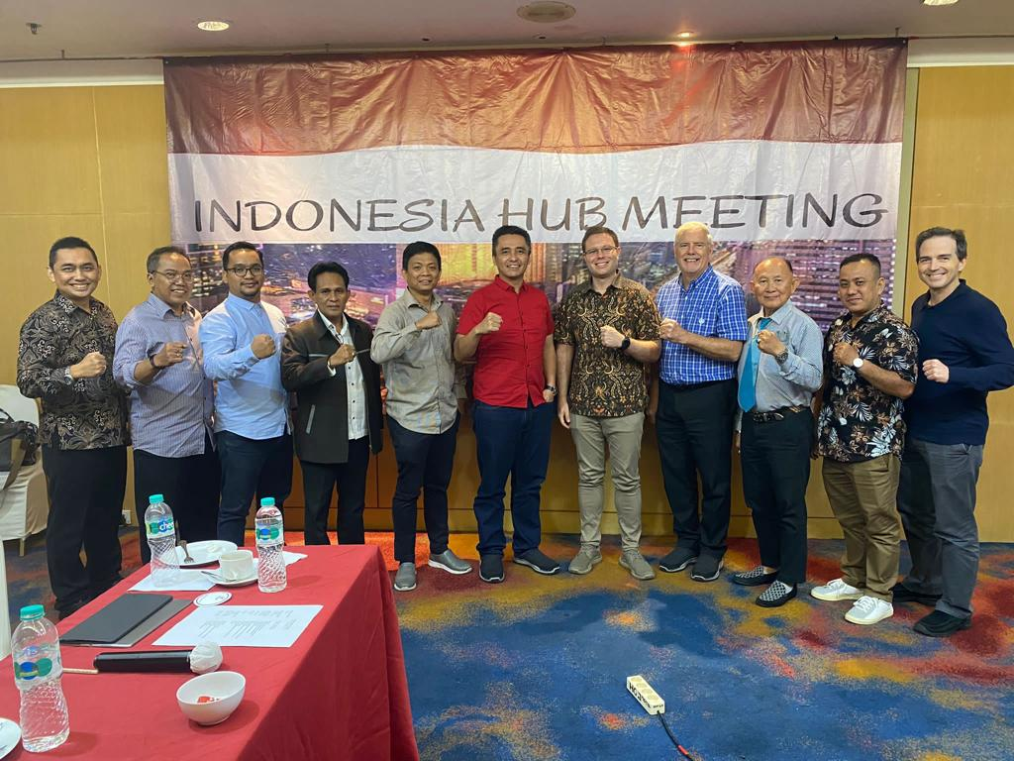
Indonesia hub’s activities
After Covid
Indonesia Hub Meeting in 2022
“The meeting took place to foster fellowship among members of the Indonesia hub, allowing them to share updates on God’s work in their ministries. And also, tim freeman presented information about globeserve.”
4

Slide 10
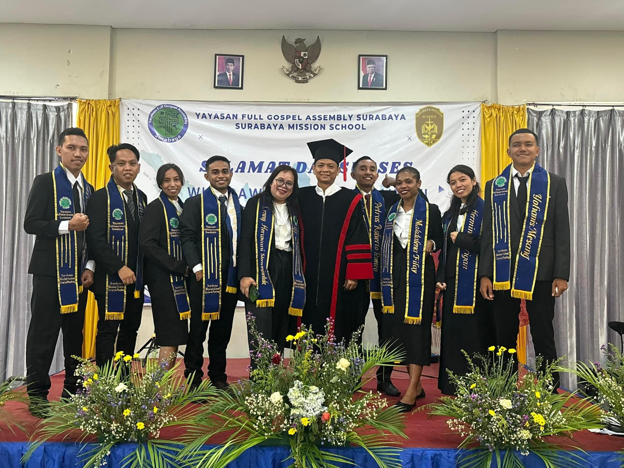
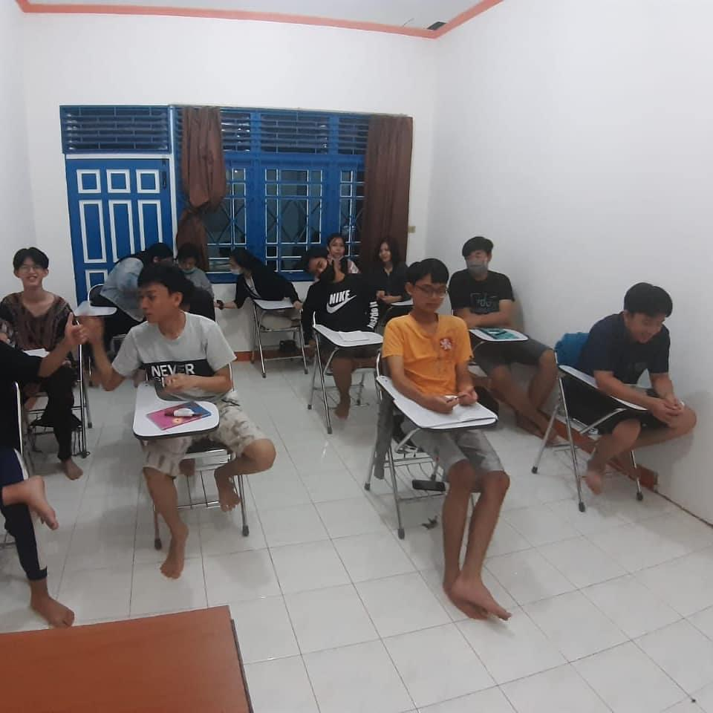
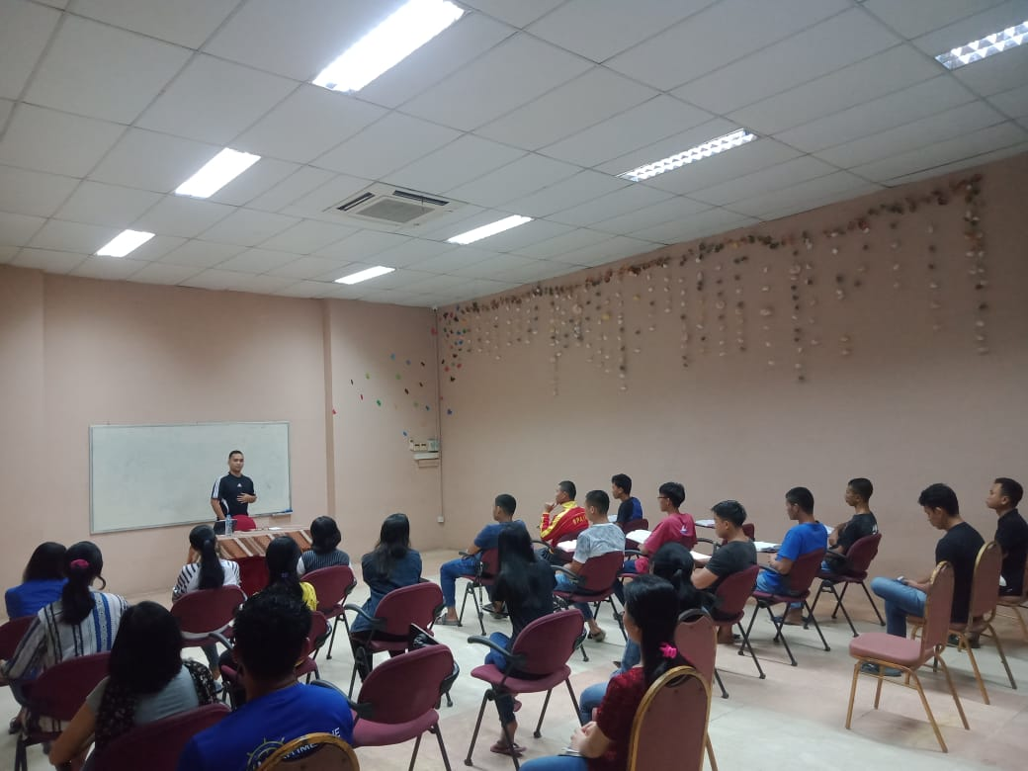
Indonesia hub’s activities
January – December 2023
Indonesia Hub Members’ Mission School
“all remain committed to providing training and equipping individuals for mission work among the UPGs.”
4

Slide 11
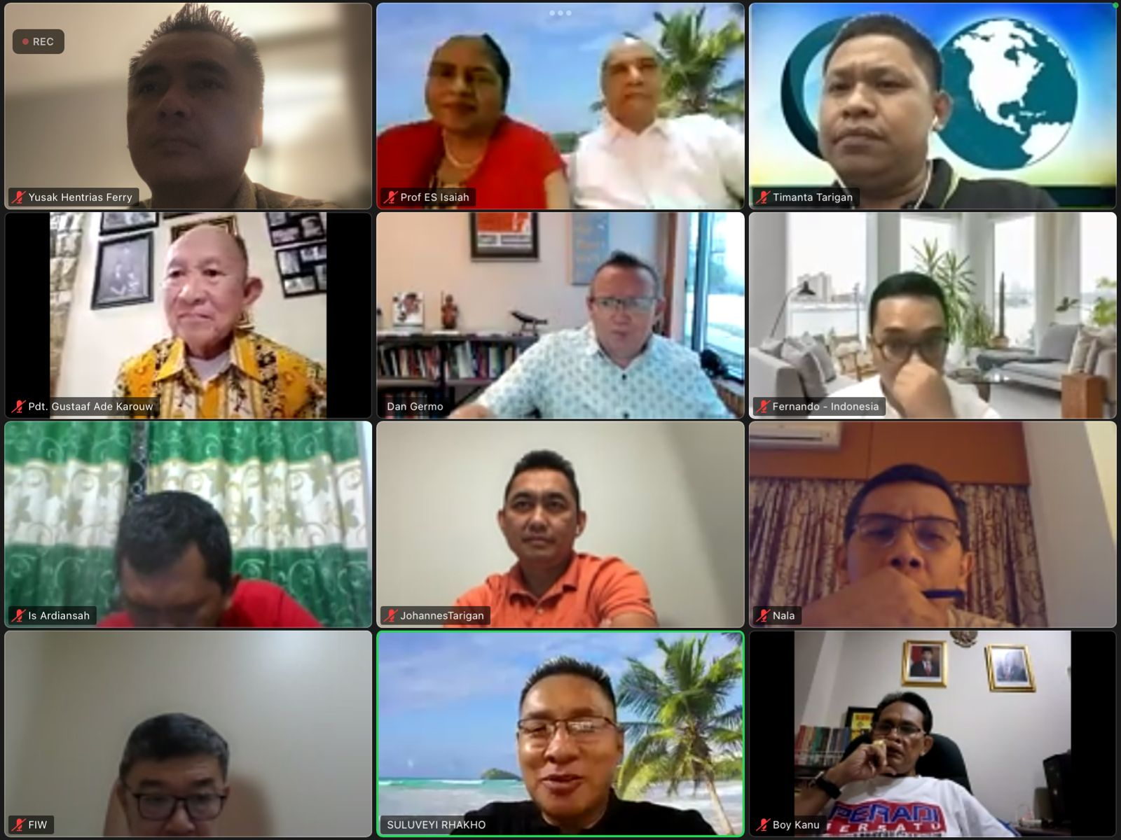
Indonesia hub’s activities
January – December 2023
Indonesia Hub Meeting
“The meeting focused on updating the leadership transition at Globeserve, providing updates on the progress of our work within each ministry in the Indonesia region, and coming together in prayer to address the challenges ahead.”
4

Slide 12
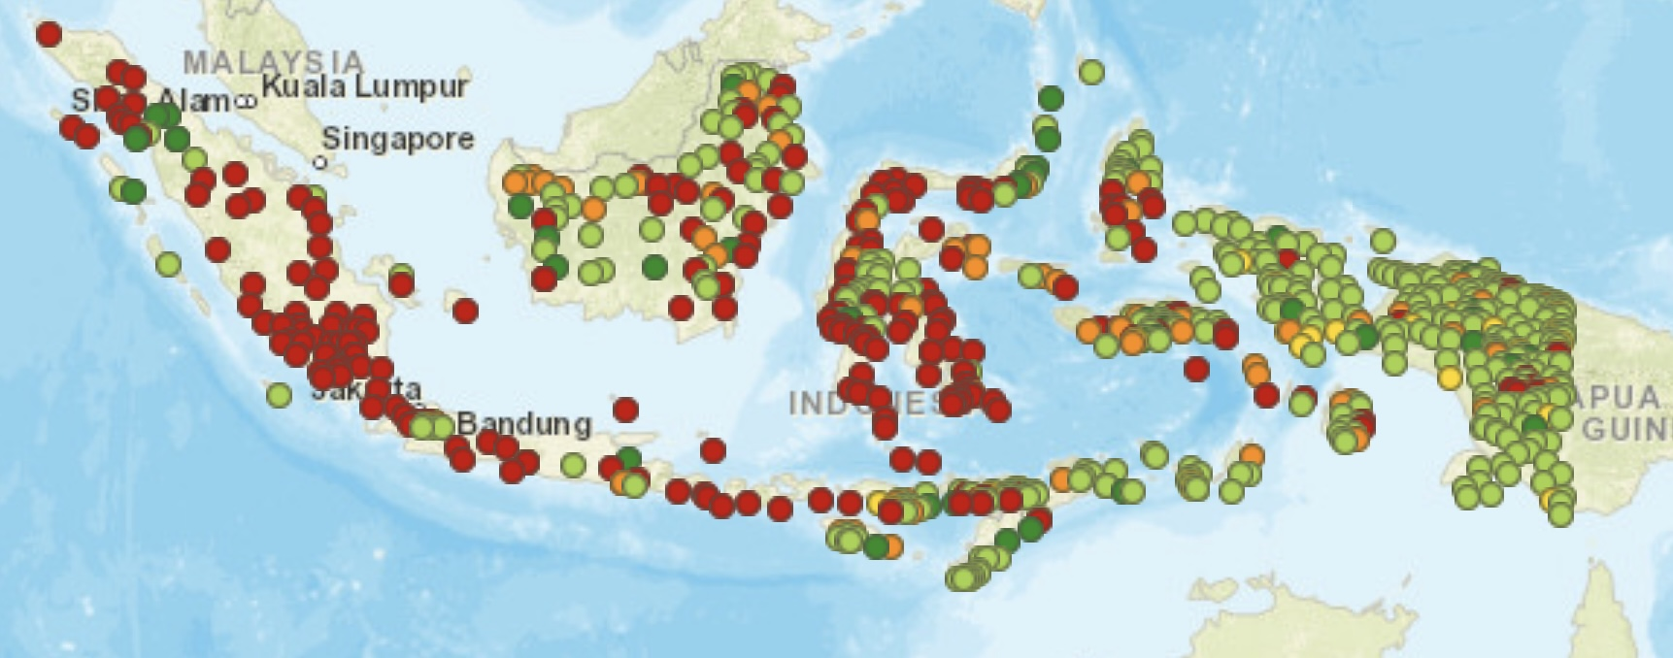
Unreached People Groups
In Indonesia
It is estimated that there are 239 Unreached People Groups in Indonesia, particularly concentrated in regions as Sumatera, Java, Kalimantan, and Sulawesi.
In Indonesia Hub, a significant amount of recent work has successfully progressed to the early disciple-making stage. Moreover, in some cases, the first church has already been established and planted among the UPGs.

Slide 13
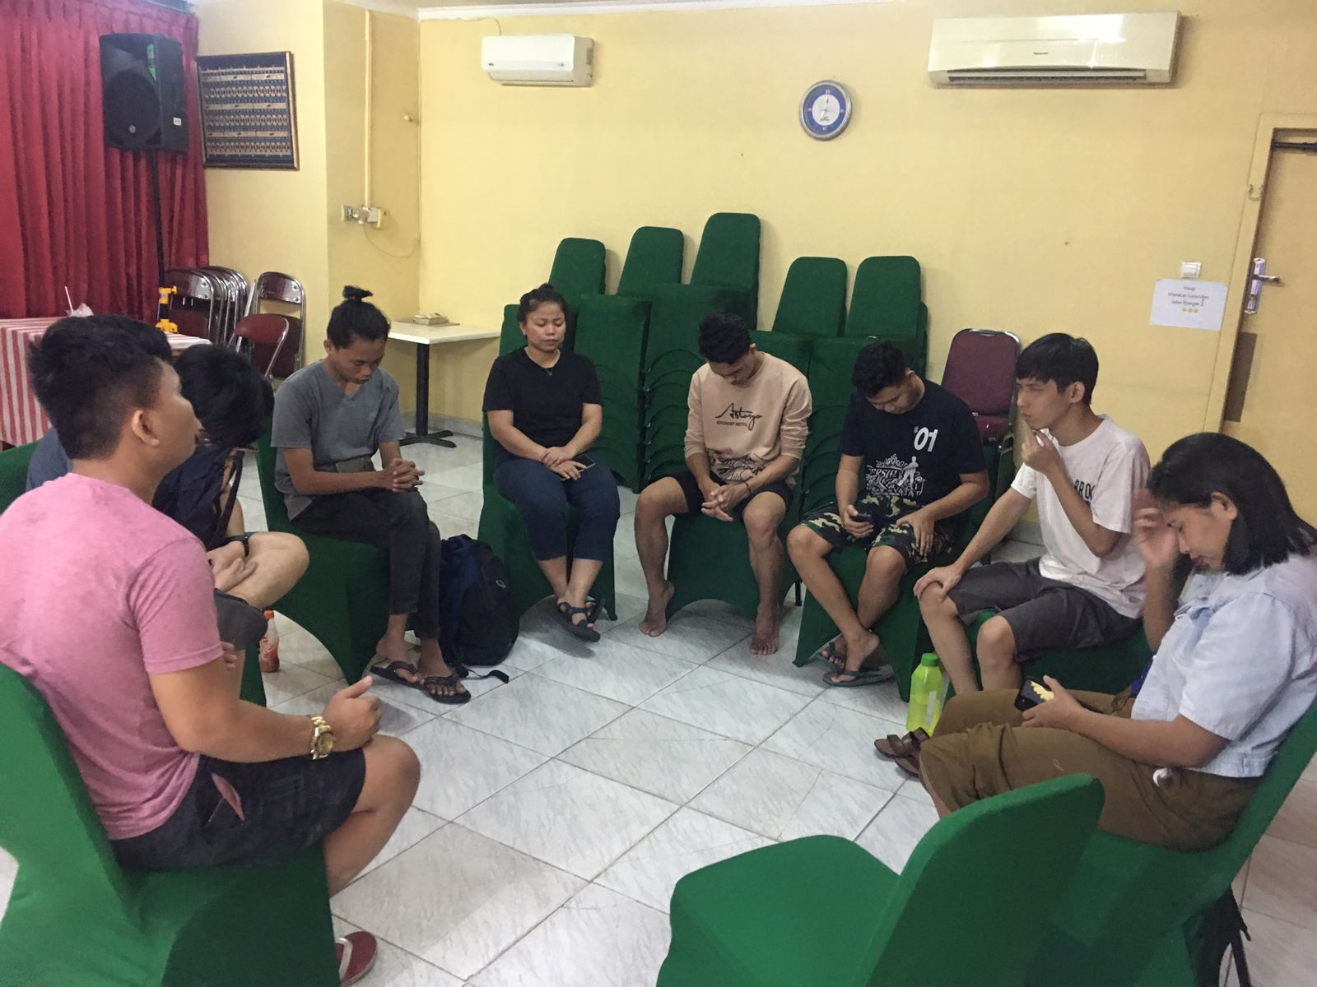
Strategies
Here are 2 of our specific strategies that are being used to reach the UPGs:
Prayer and Intercession
We recognized the spiritual nature of the work, therefore prayer plays a vital role in Indonesia Hub’s effort to reach the UPGs in Indonesia.
Praying for open doors, receptive hearts, and divine guidance have been pave our way to successful outreach efforts.

Slide 14
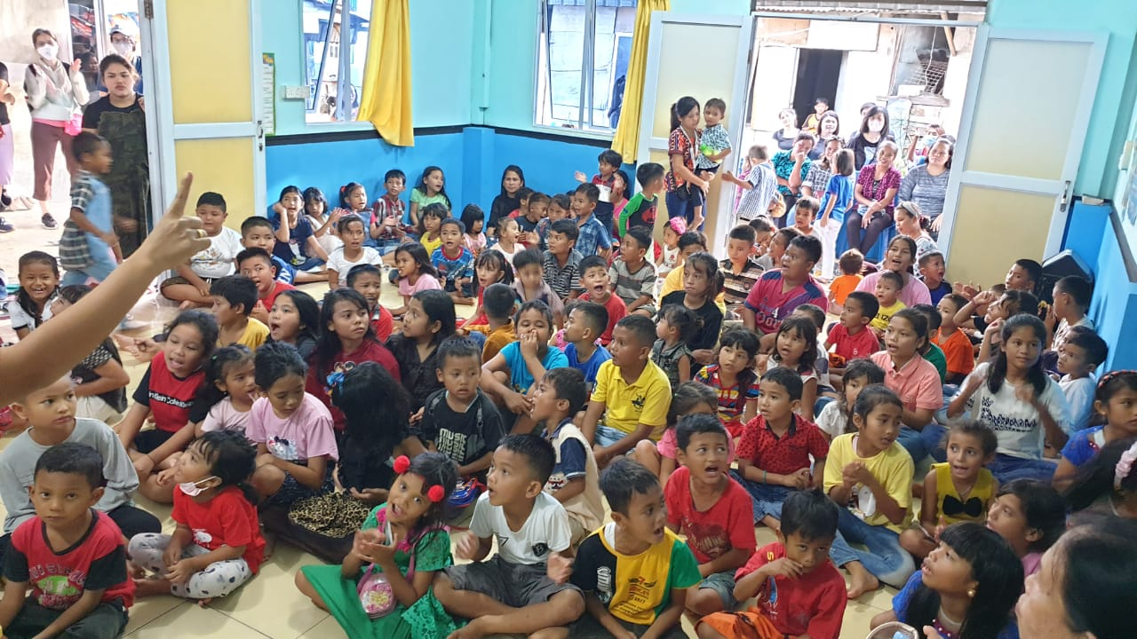
Strategies
A Holistic Children’s Program
Children's program that combines education, games, hygiene education, and Christian values is a powerful tool for reaching the UPGs in Indonesia. This program involves parents and the community, creating opportunities for outreach and building relationship with families who may not have been reached through traditional means.
This program helps foster trust and acceptance within the community, making it easier to share the message of hope and love found in Jesus

Slide 15
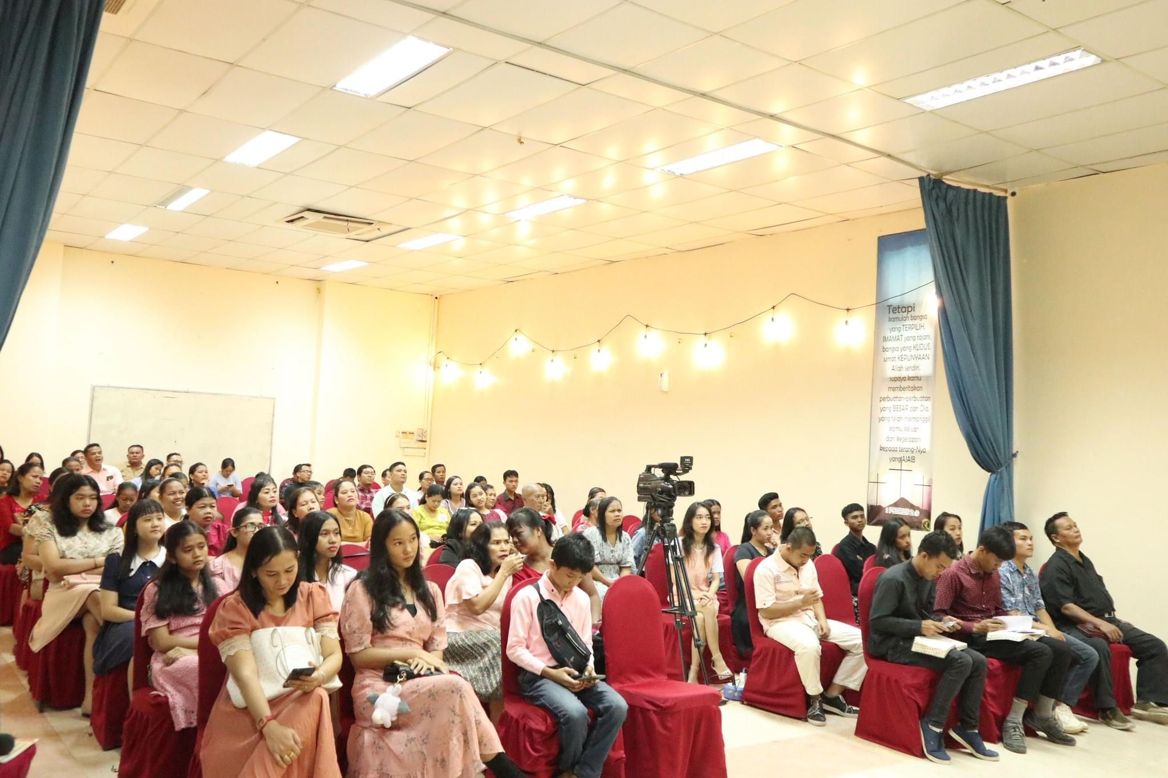
Indonesia hub
Strength of the Church
Growing Numbers
“The believers population in Indonesia Hub has been growing steadily over the years, with many churches experiencing an increase in new believers’ membership.”
4

Slide 16
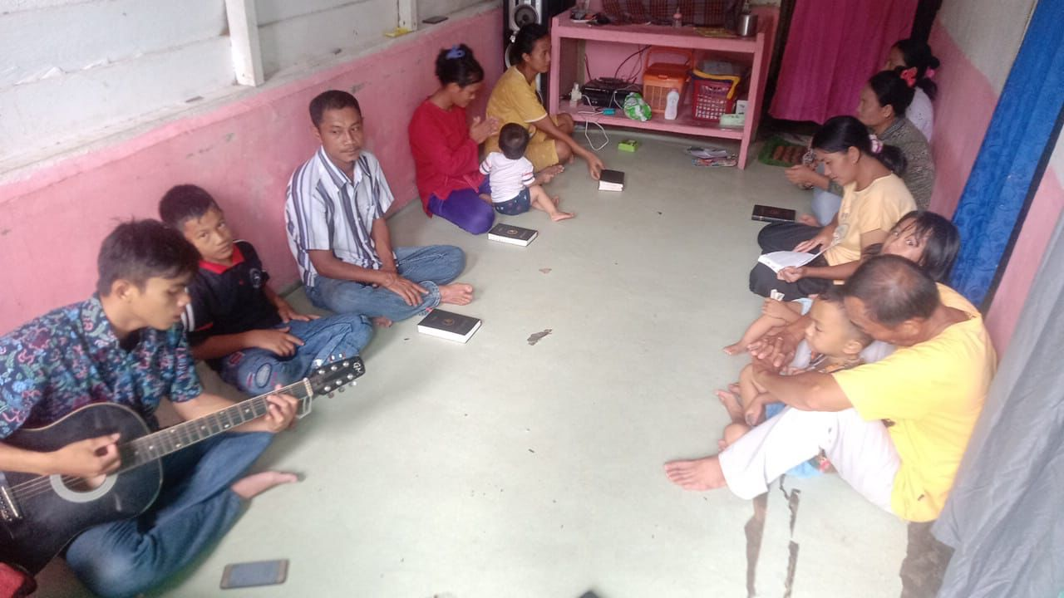
Indonesia hub
Strength of the Church
Active Participation
“Many believers in Indonesia Hub ministry are actively involved in their churches and communities, participating in worship services, discipleship, evangelism, volunteer work, and outreach programs.”
4

Slide 17
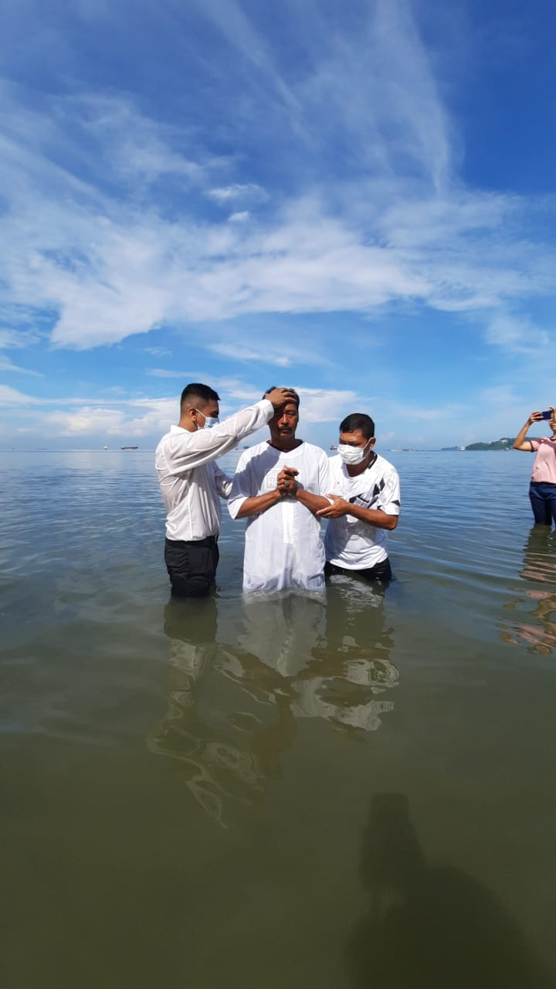
Indonesia hub
Current Level of Engagement
Level of Engagement of the church within the UPGs
“The current level of engagement of the church within the UPGs is to make early disciples and plant the first churches among some UPGs. These efforts have involved building relationships with community members, sharing the Gospel message, providing practical support, and training local believers to become leaders within their communities.”
4

Slide 18
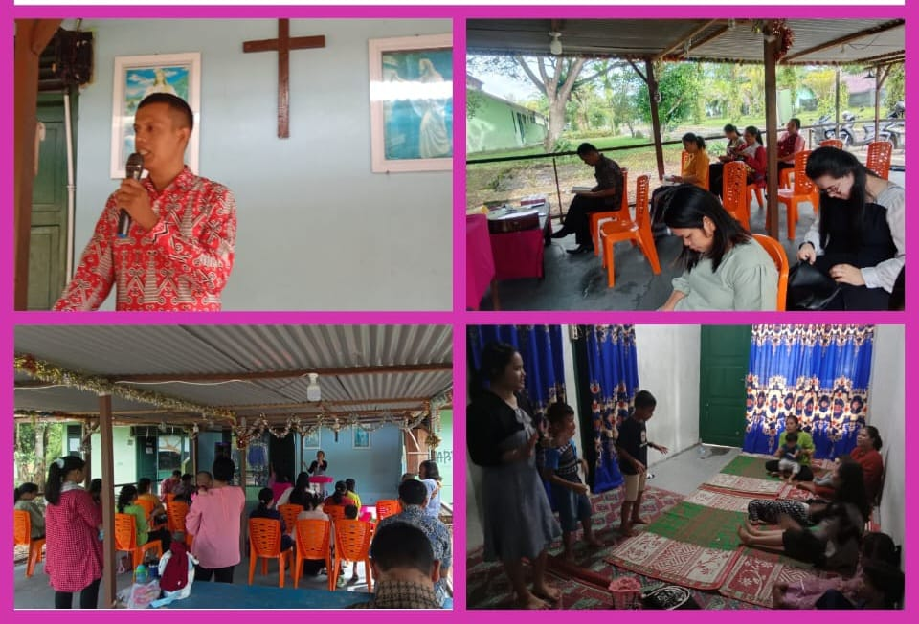
Indonesia hub
Example of Successful Engagement
Anneuk Jammee Tribe
“Praise the Lord, with unwavering determination and compassion, the missionaries sent by the Indonesian hub member have been able to establish the first church in the tribe. Through their relentless efforts and God’s open door, the individuals of the community are coming to Christ and in unity come to worship HIM.”
4

Slide 19
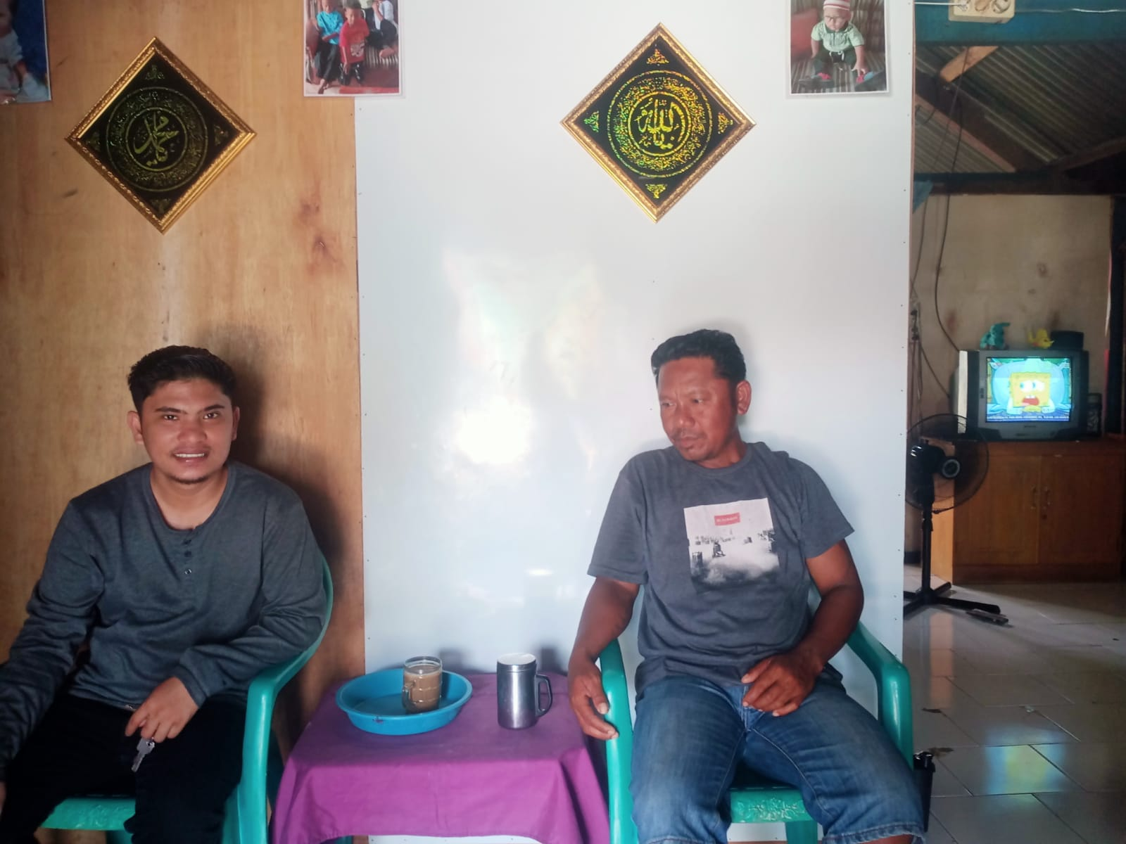
Indonesia hub
Example of Successful Engagement
Bajao Tribe
“Meanwhile, in the coastal waters of Indonesia, some of the Bajao Tribe were captivated by the Gospel of Jesus Christ preached by the missionaries and became the first disciples. through their newfound faith, the disciples found a sense of calling to reach out their own people.”
4

Slide 20
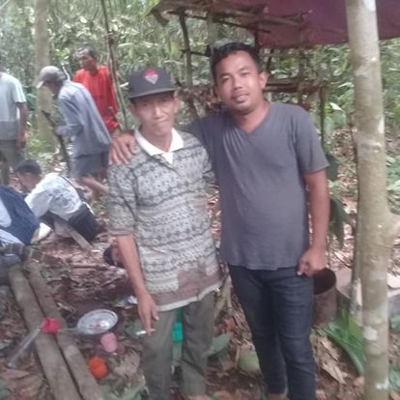
Indonesia hub
Example of Successful Engagement
Punam Merah Tribe
“Far in the remote mountain of Indonesia, the missionaries are working to reach the Punam Merah Tribe. The missionaries faced numerous challenges but remained steadfast in their mission.”
4

Slide 21
Indonesia hub
Opportunities & Challenges
Significant Opportunities
Young population
Engaging with the young people through mission work will have a lasting impact on the mission’s future and values of the next generations.
2. Rural communities
Indonesia is made up of thousands of islands, many of which are home to rural communities with limited access to resources and services. Missions work in these areas can provide much-needed support in terms of education, healthcare, and community development.
3. Disaster Relief
Indonesia is prone to natural disasters such as earthquakes, floods, tsunamis, and volcanic eruptions. Indonesia Hub can play a crucial role in providing disaster relief and send missionaries to follow up through mission work.
4

Slide 22
Indonesia hub
Opportunities & Challenges
Major Challenges
Religious tensions
Indonesia has experienced religious tensions and occasional incidents of violence targeting religious minorities, including Christians. This is one of the challenges to the church’s growth and outreach efforts.
2. Legal restriction
Some regions in Indonesia have regulations that limit the construction of new churches or restrict Christians activities, which can hinder the church’s ability to expand.
3. Social Issues
The church in Indonesia Hub have faced challenges related to social issues such as poverty, inequality, and access to education and healthcare
4

Slide 23
Mission Work in Indonesia Hub is marked by
both opportunities and Challenges.
Please keep us in your prayer, that we may address the challenges led by the Holy Spirit and working towards unity and collaboration of the leaders in Indonesia Hub, there is hope for a bright future for Mission Work in Indonesia

