Slide 1

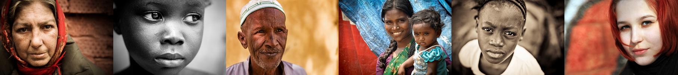
RESEARCH & INFORMATION

Slide 2

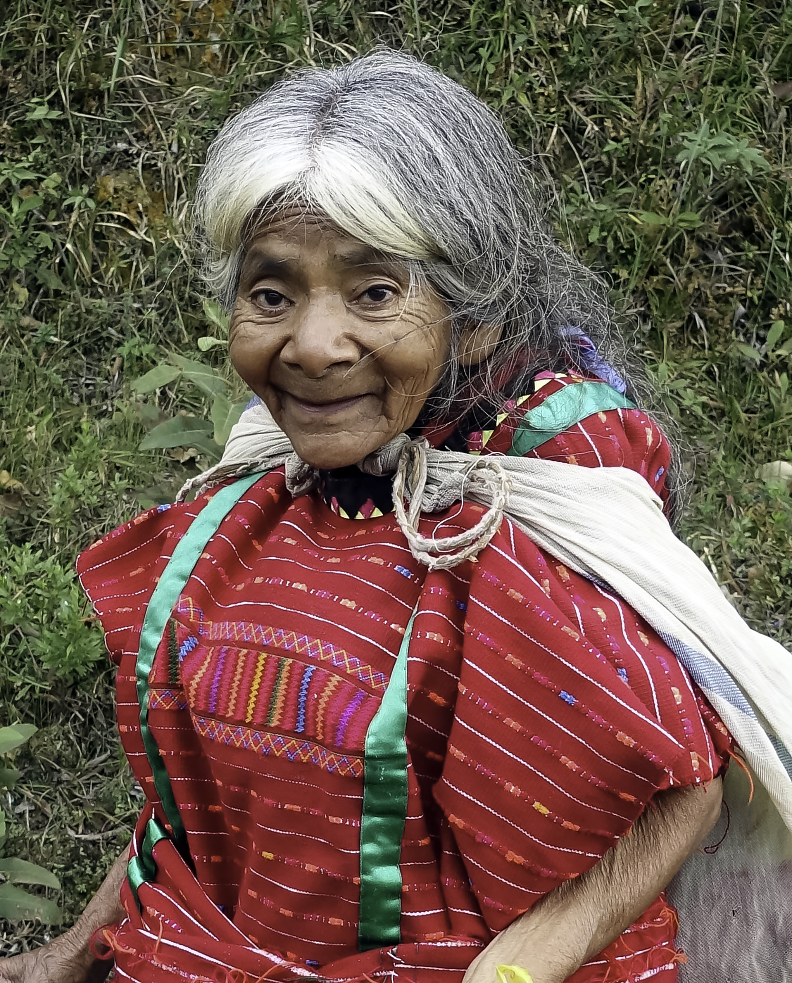
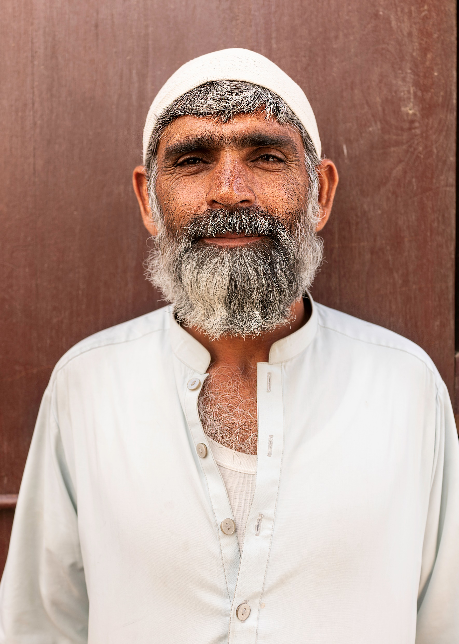
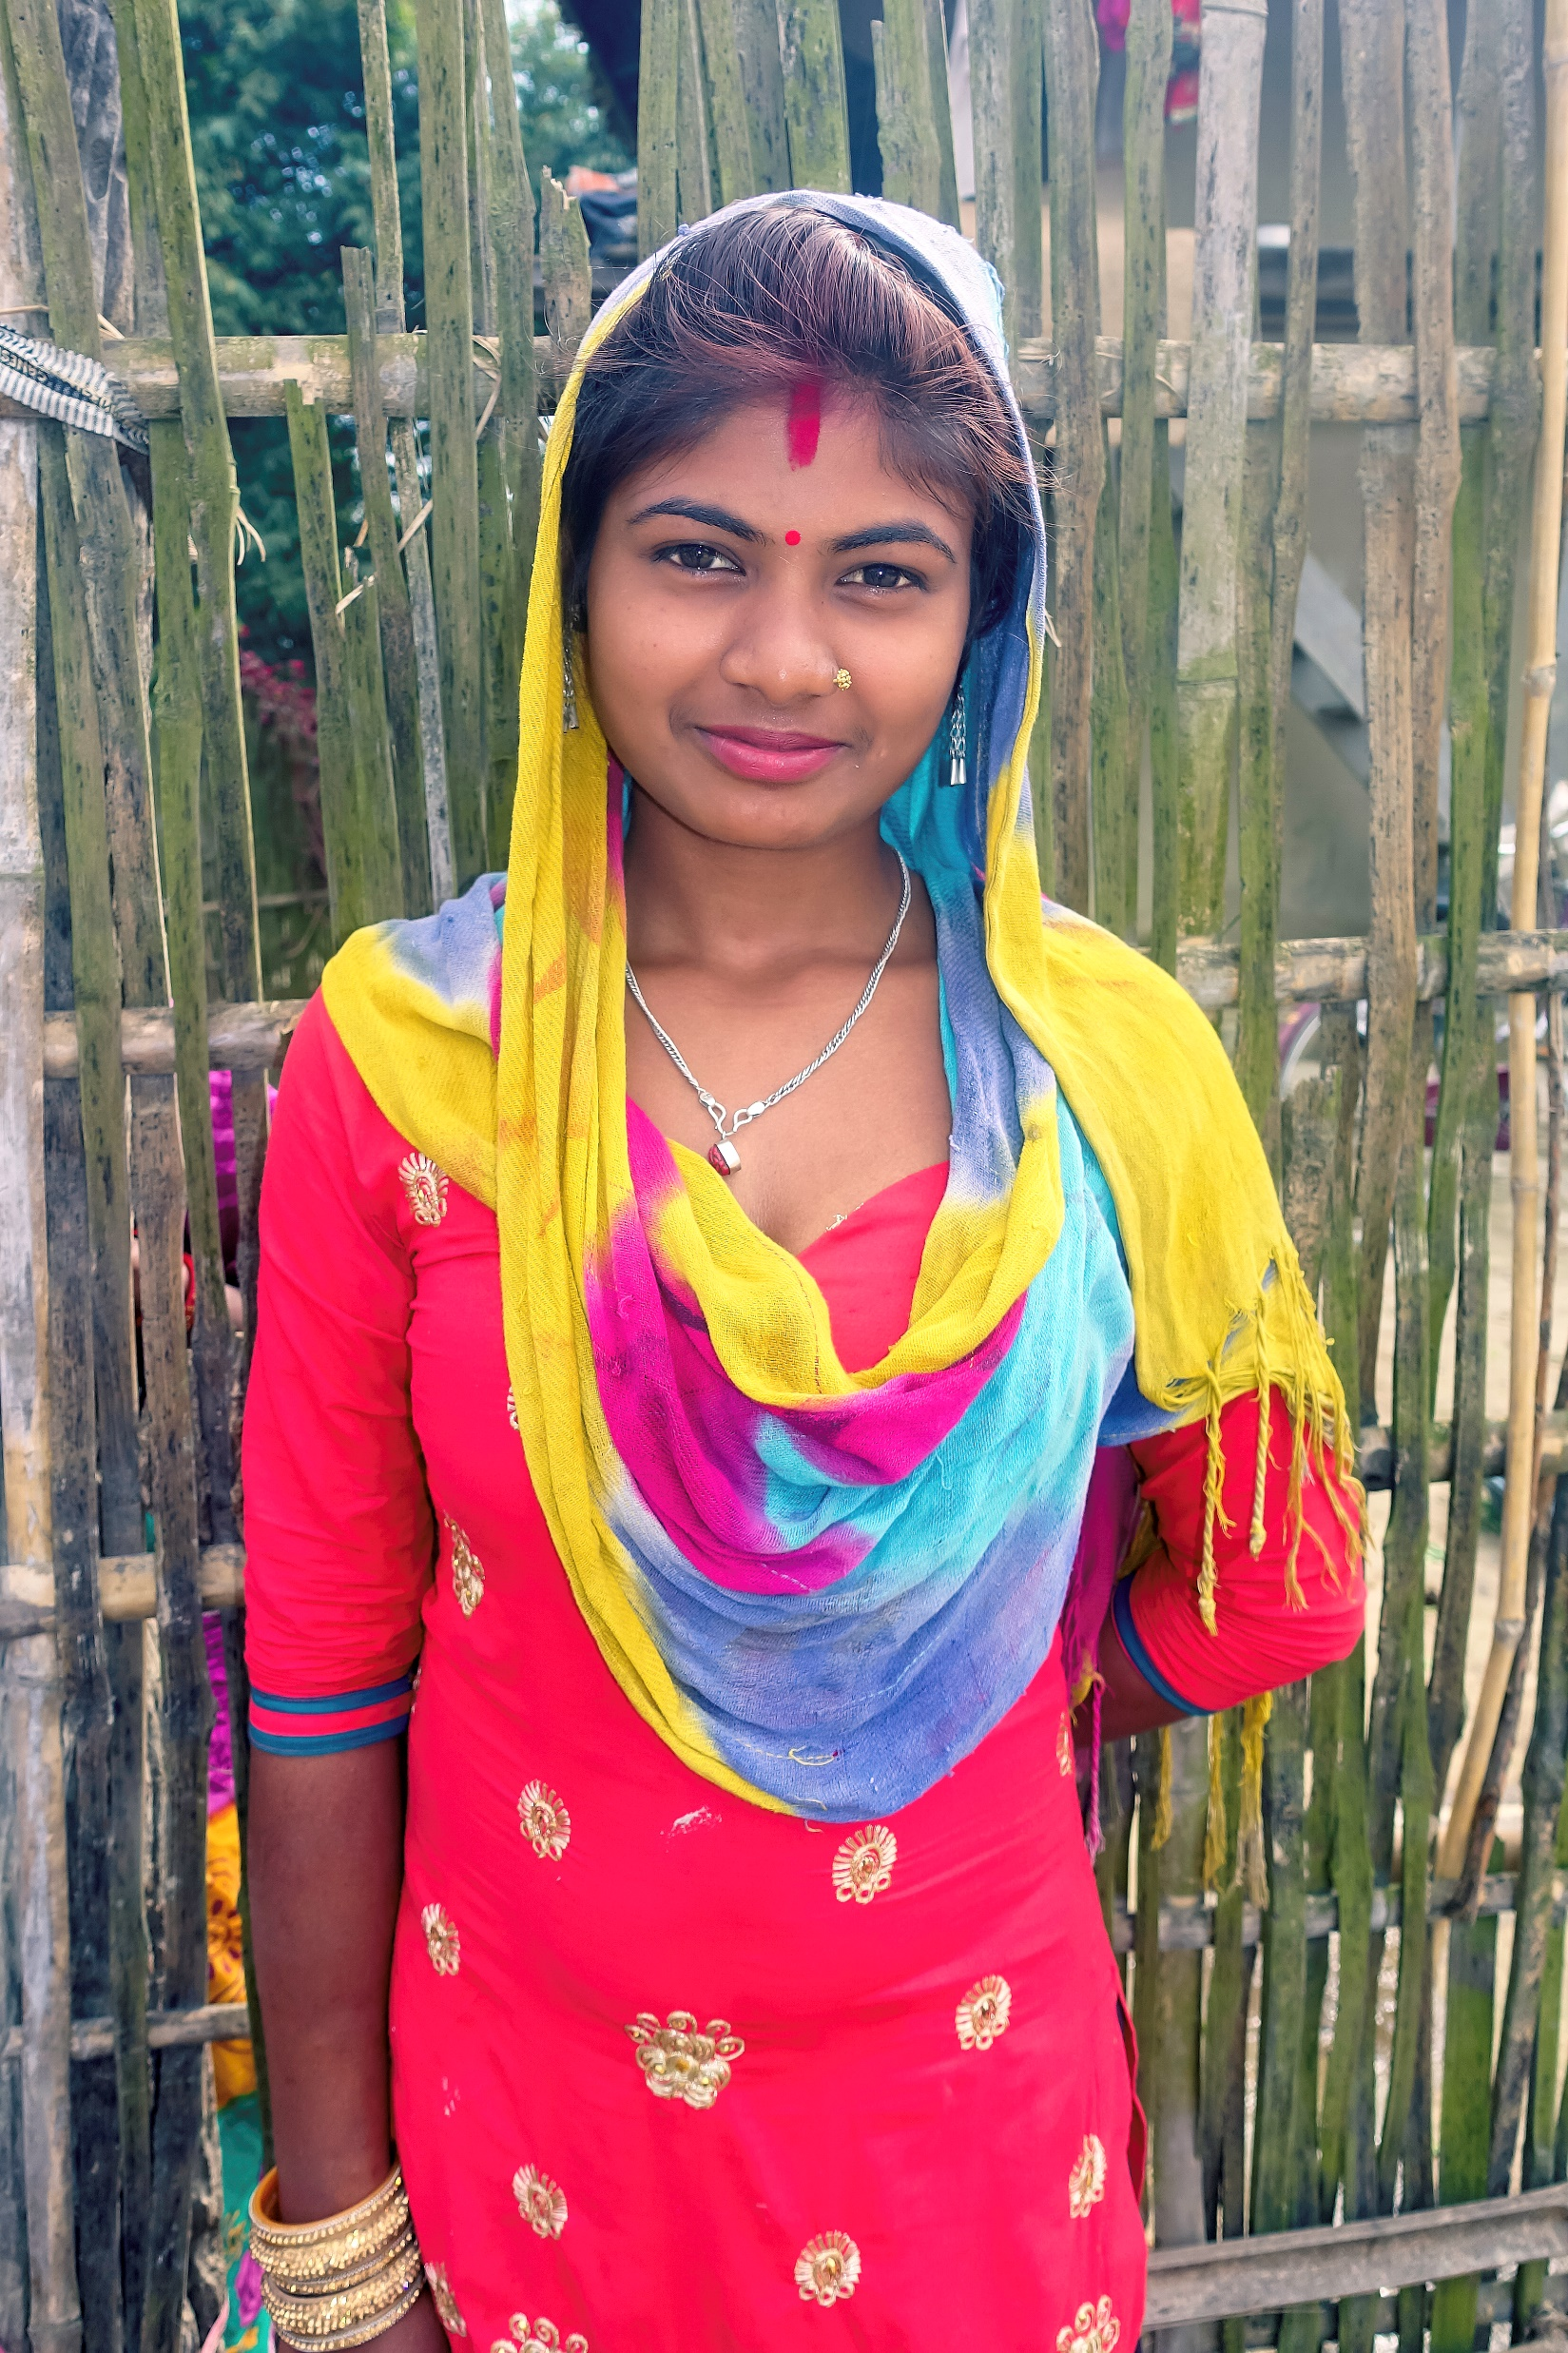

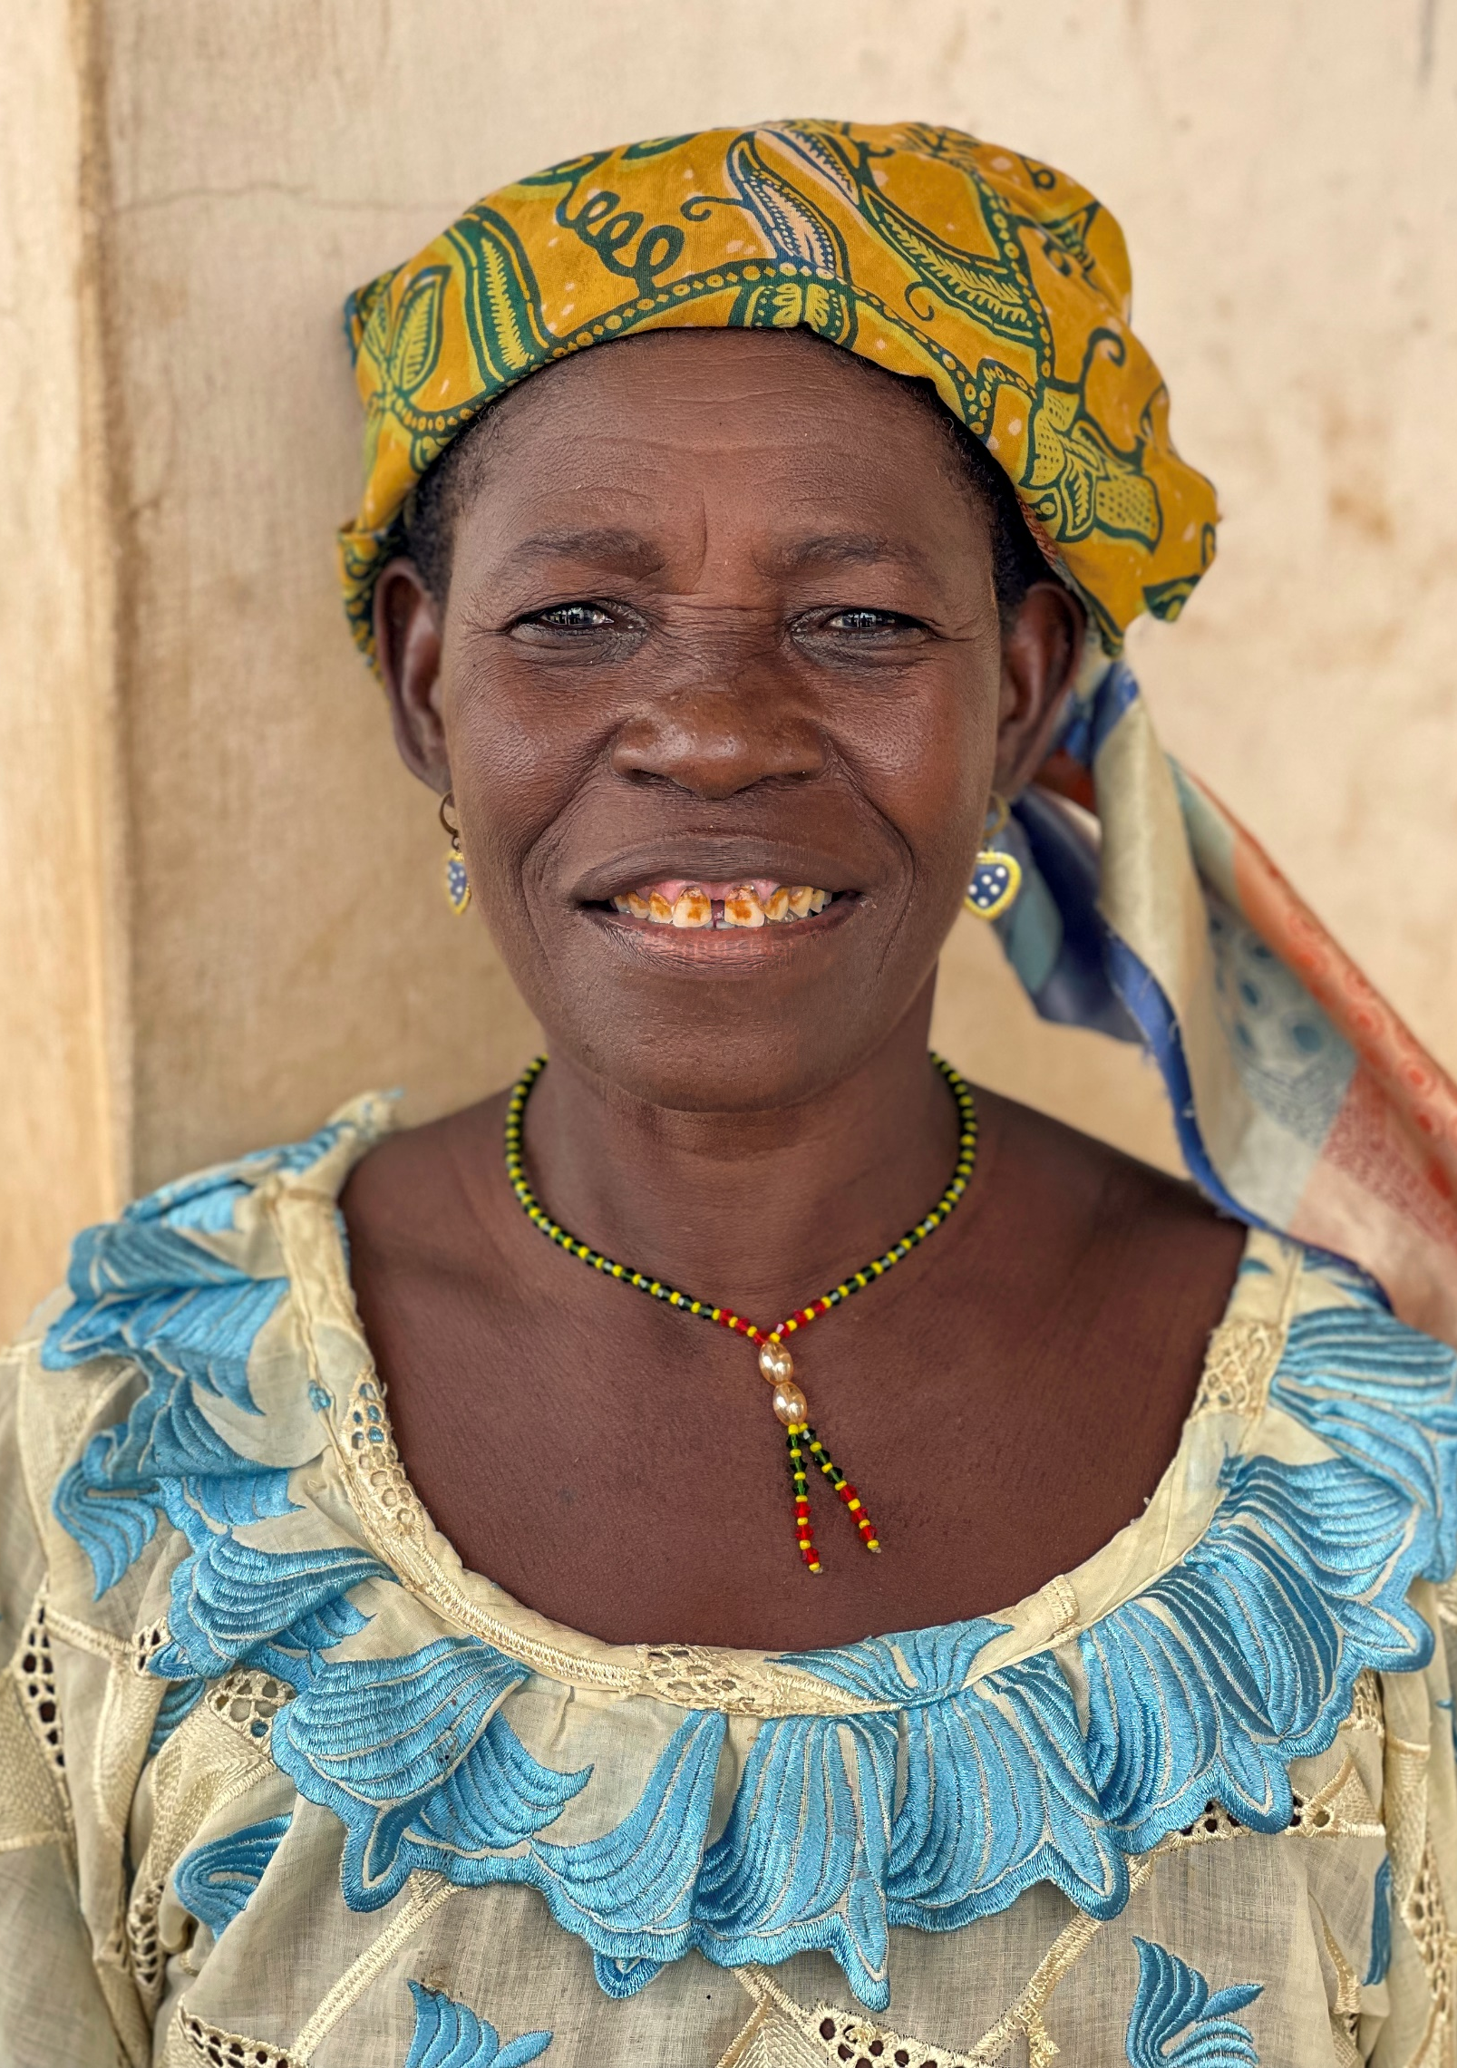

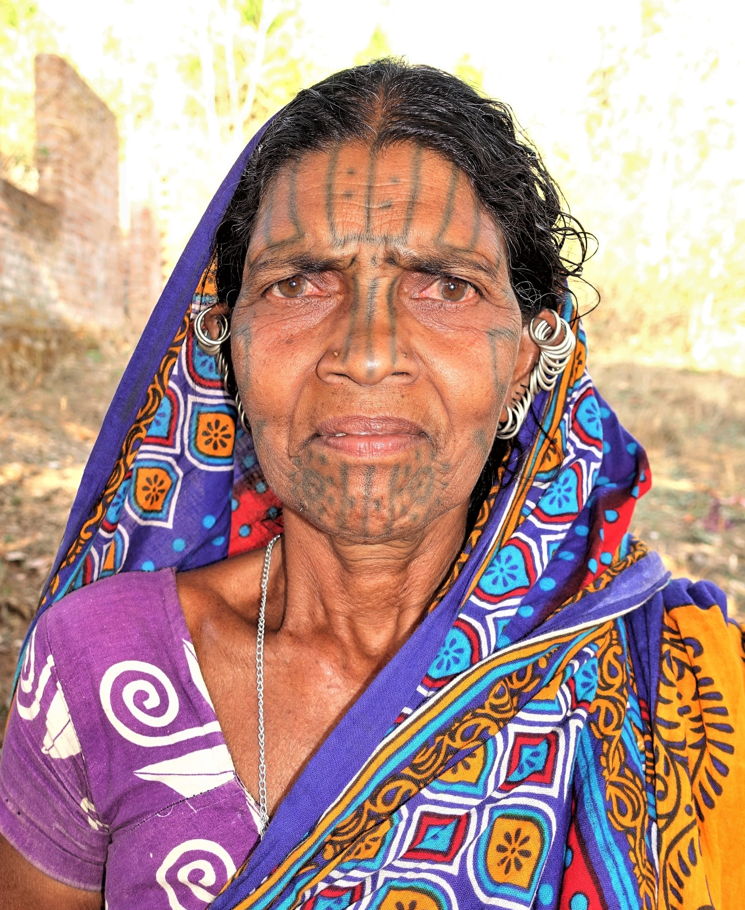
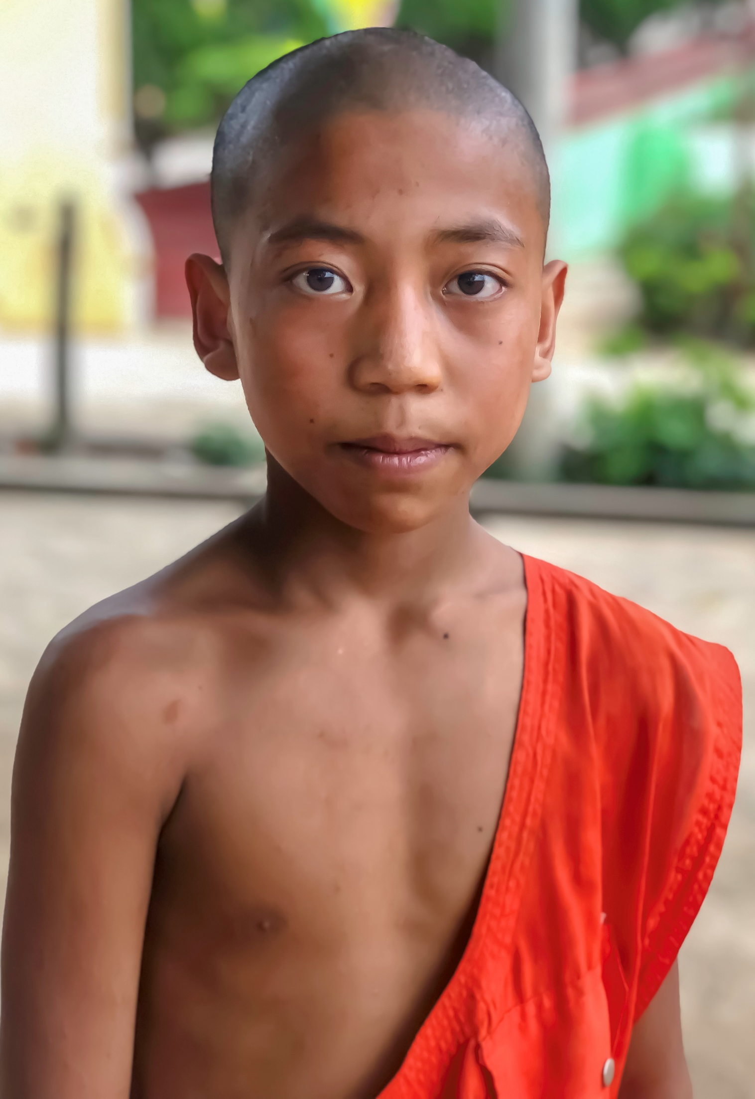
UNREACHED PEOPLE GROUPS RESEARCH
JUNE 11-14, 2024 – NAIROBI, KENYA
Notes:
During the COVID period, research has diminished, but vetting was largely carried out by Seth Neterer, who was instrumental to setting up a database called Sales Force. This system enables us to better track of the statistics. You will note that there has been some disengagement as a result of COVID and the vetting process.
However, I am not discouraged by this, as we need to get the updated information our hubs, especially our new hubs, mostly in Africa, which have not yet reported. We anticipate considerable additions to our adoptions and engagements, as well as information regarding what I call “Pre-Movements”.

Slide 3
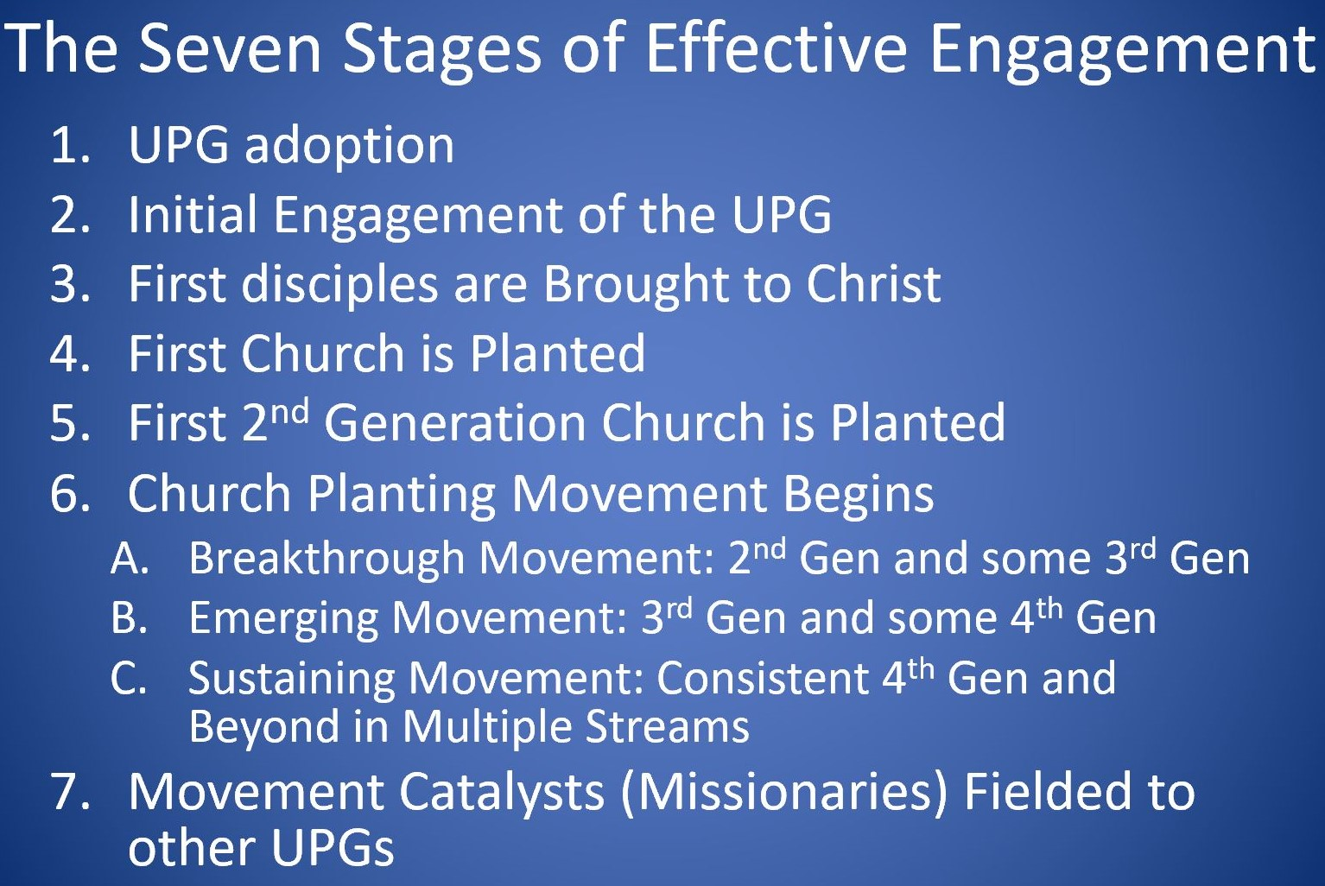
Notes:
STAGE 6A - Consistent Second-Generation Churches come into Existence​. Some Third Generation Churches are planted​.
STAGE 6B - Consistent 3rd Generation Churches are Established​. Some 4th Generation Churches are Planted​.
STAGE 6C - Consistent 4th Generation Churches are Established​. The Movement goes Beyond the 4th Generation into yet more Generations​. The Movement goes into Multiple Streams​.

Slide 4
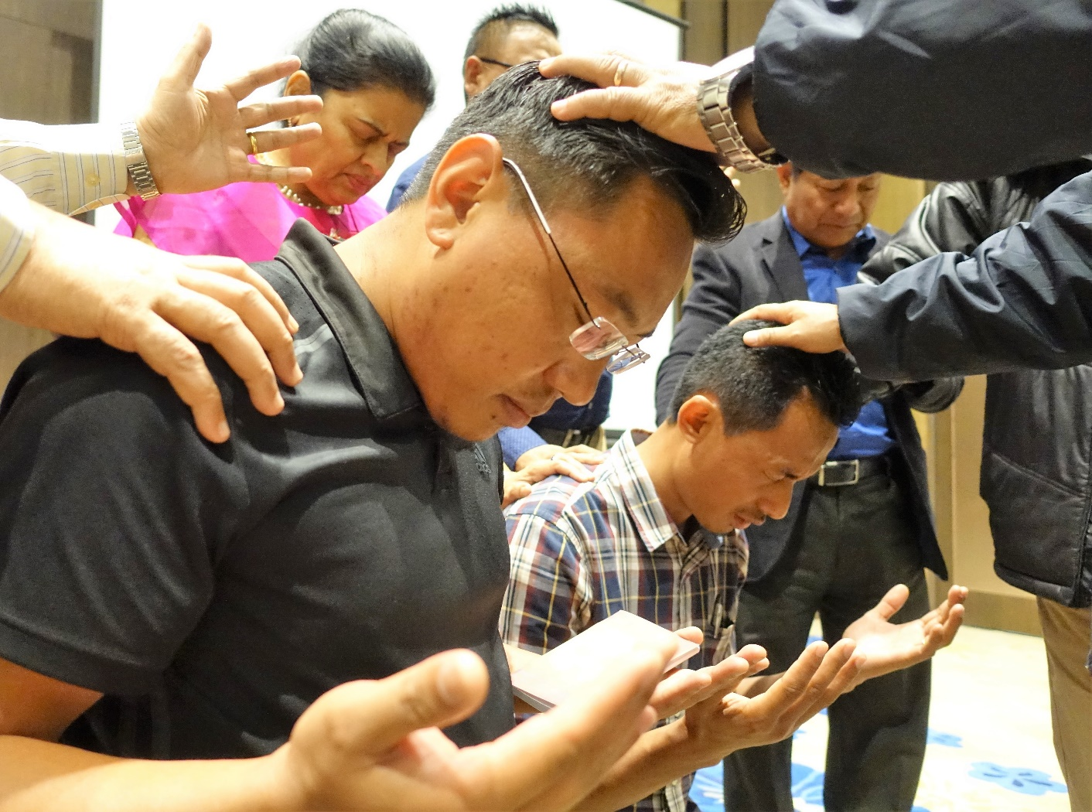
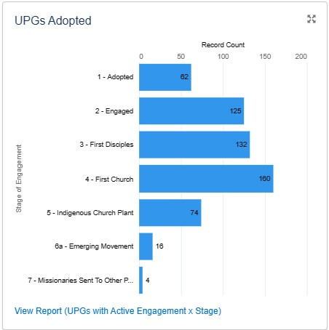
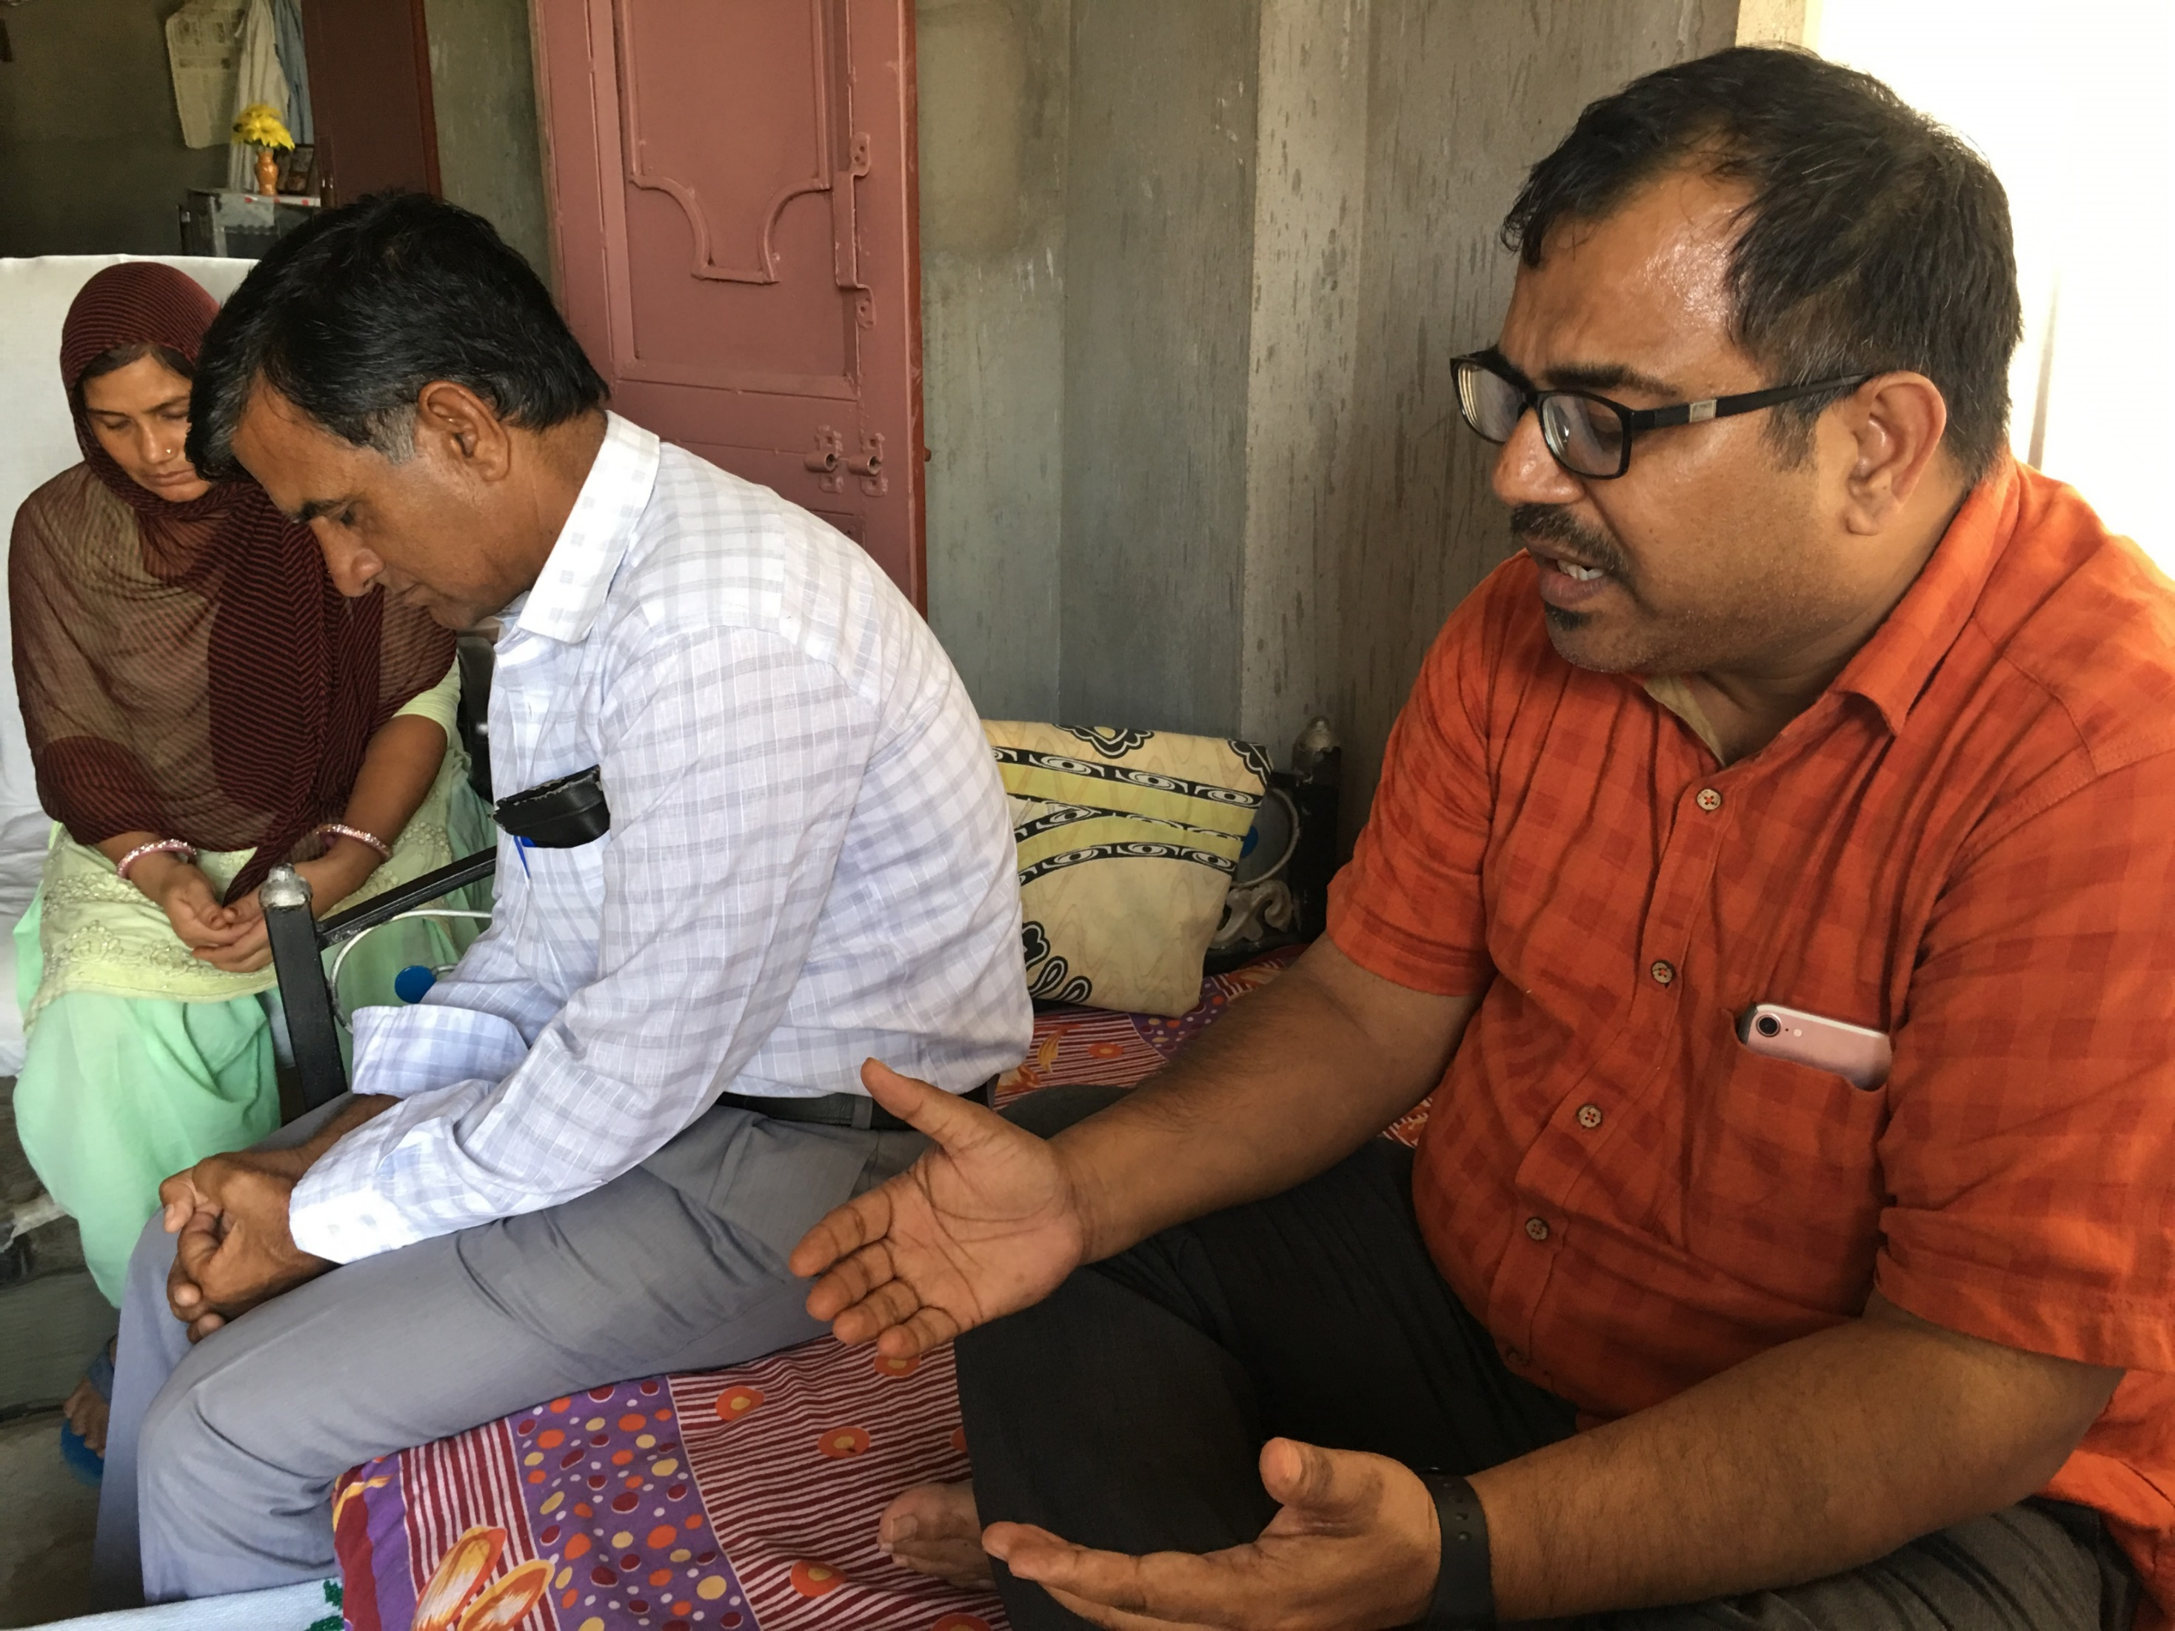
UPG ENGAGEMENT SCALE – ”7 STAGES”
511 ENGAGED
573 TOTAL ADOPTIONS & ENGAGED

Slide 5
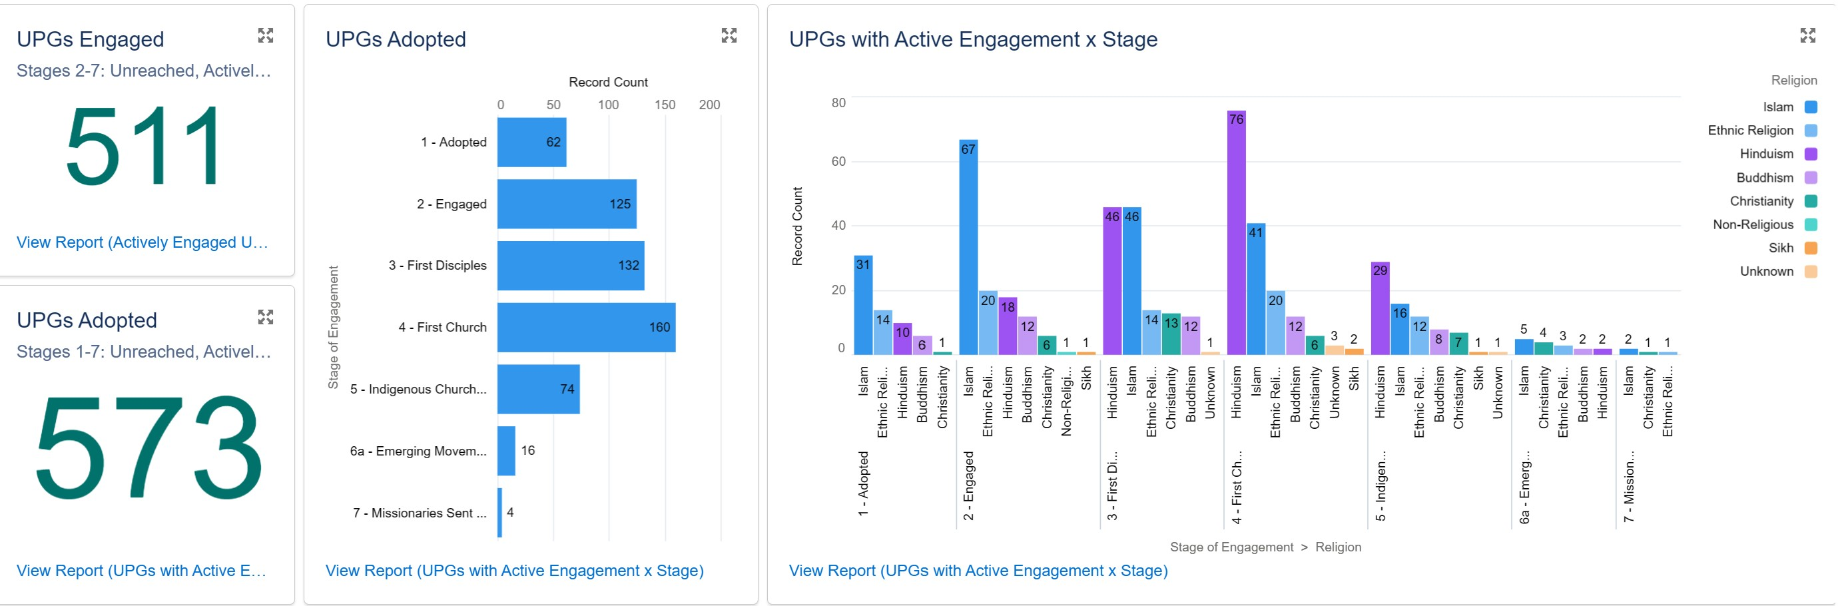
UPGS ADOPTED & ENGAGED
511 ENGAGED UPGS
679 TOTAL ENGAGMENTS (168 UPGS WITH MULTIPLE ENGAGEMENTS)
573 ACTIVELY ADOPTED
858 UPS ADOPTED (TOTAL)

Slide 6
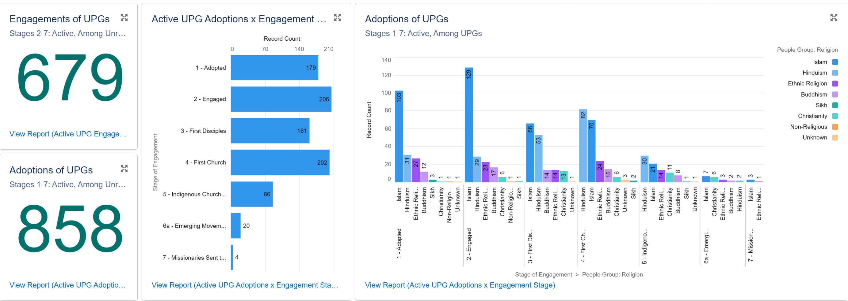
TOTAL UPGS ADOPTED & ENGAGED
Notes:
Multiple engagments across all organizations. Example: The Fulani are listed 10 times, as they are adopted/engaged by 10 organizations in 7 countries.

Slide 7
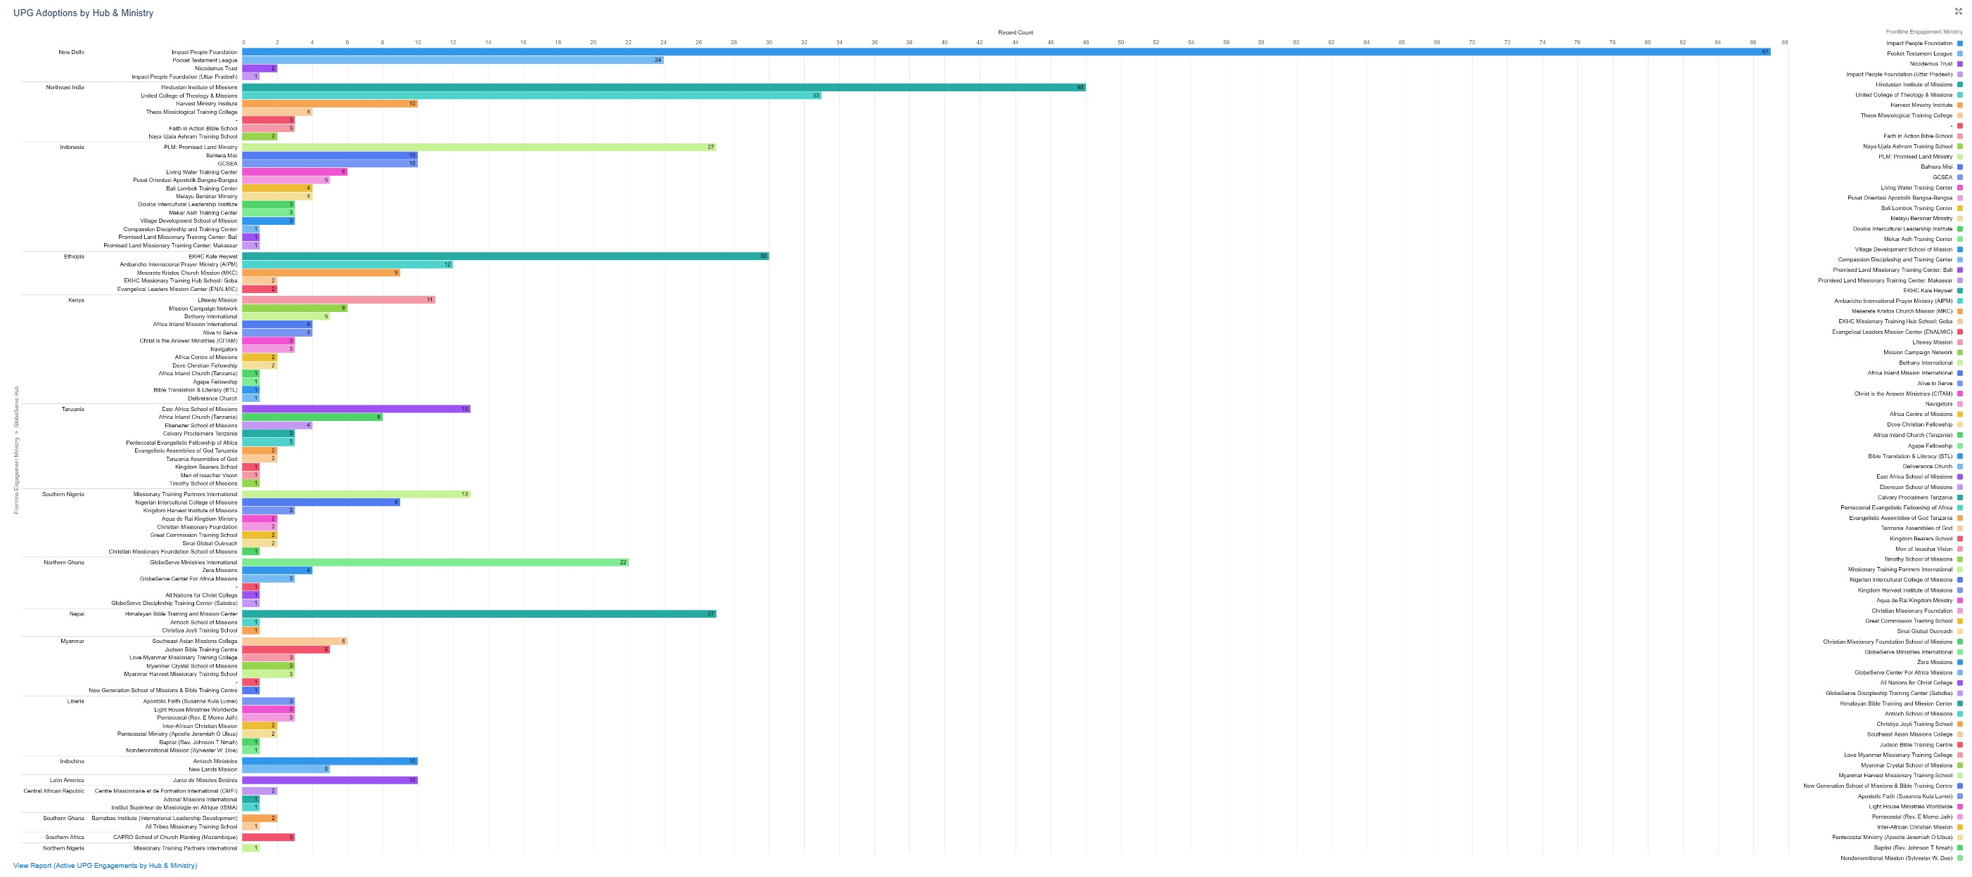
UPG ENGAGEMENTS BY HUB & MINISTRY

Slide 8
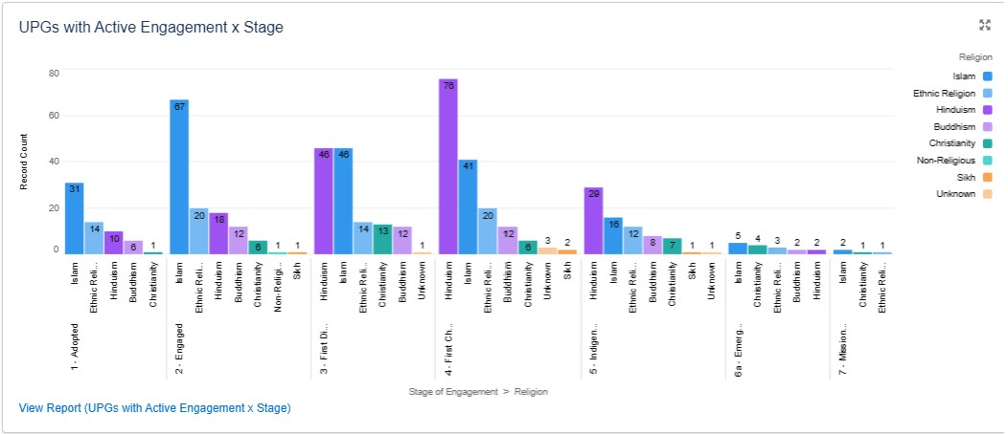
UPG ENGAGEMENTS STAGES BY RELIGION

Slide 9
UPG ENGAGEMENTS BY GS REGION
ANGLOPHONE WEST AFRICA… 50
FRANCOPHONE WEST AFRICA… 10
3. FRANCOPHONE CENTRAL AFRICA… 3
4. EAST, SOUTHERN HORN OF AFRICA… 174
5. SOUTH ASIA… 243
6. SOUTHEAST ASIA… 21
7. INDONESIA… 77
8. SOUTH (LATIN) AMERICA… 10

Slide 10
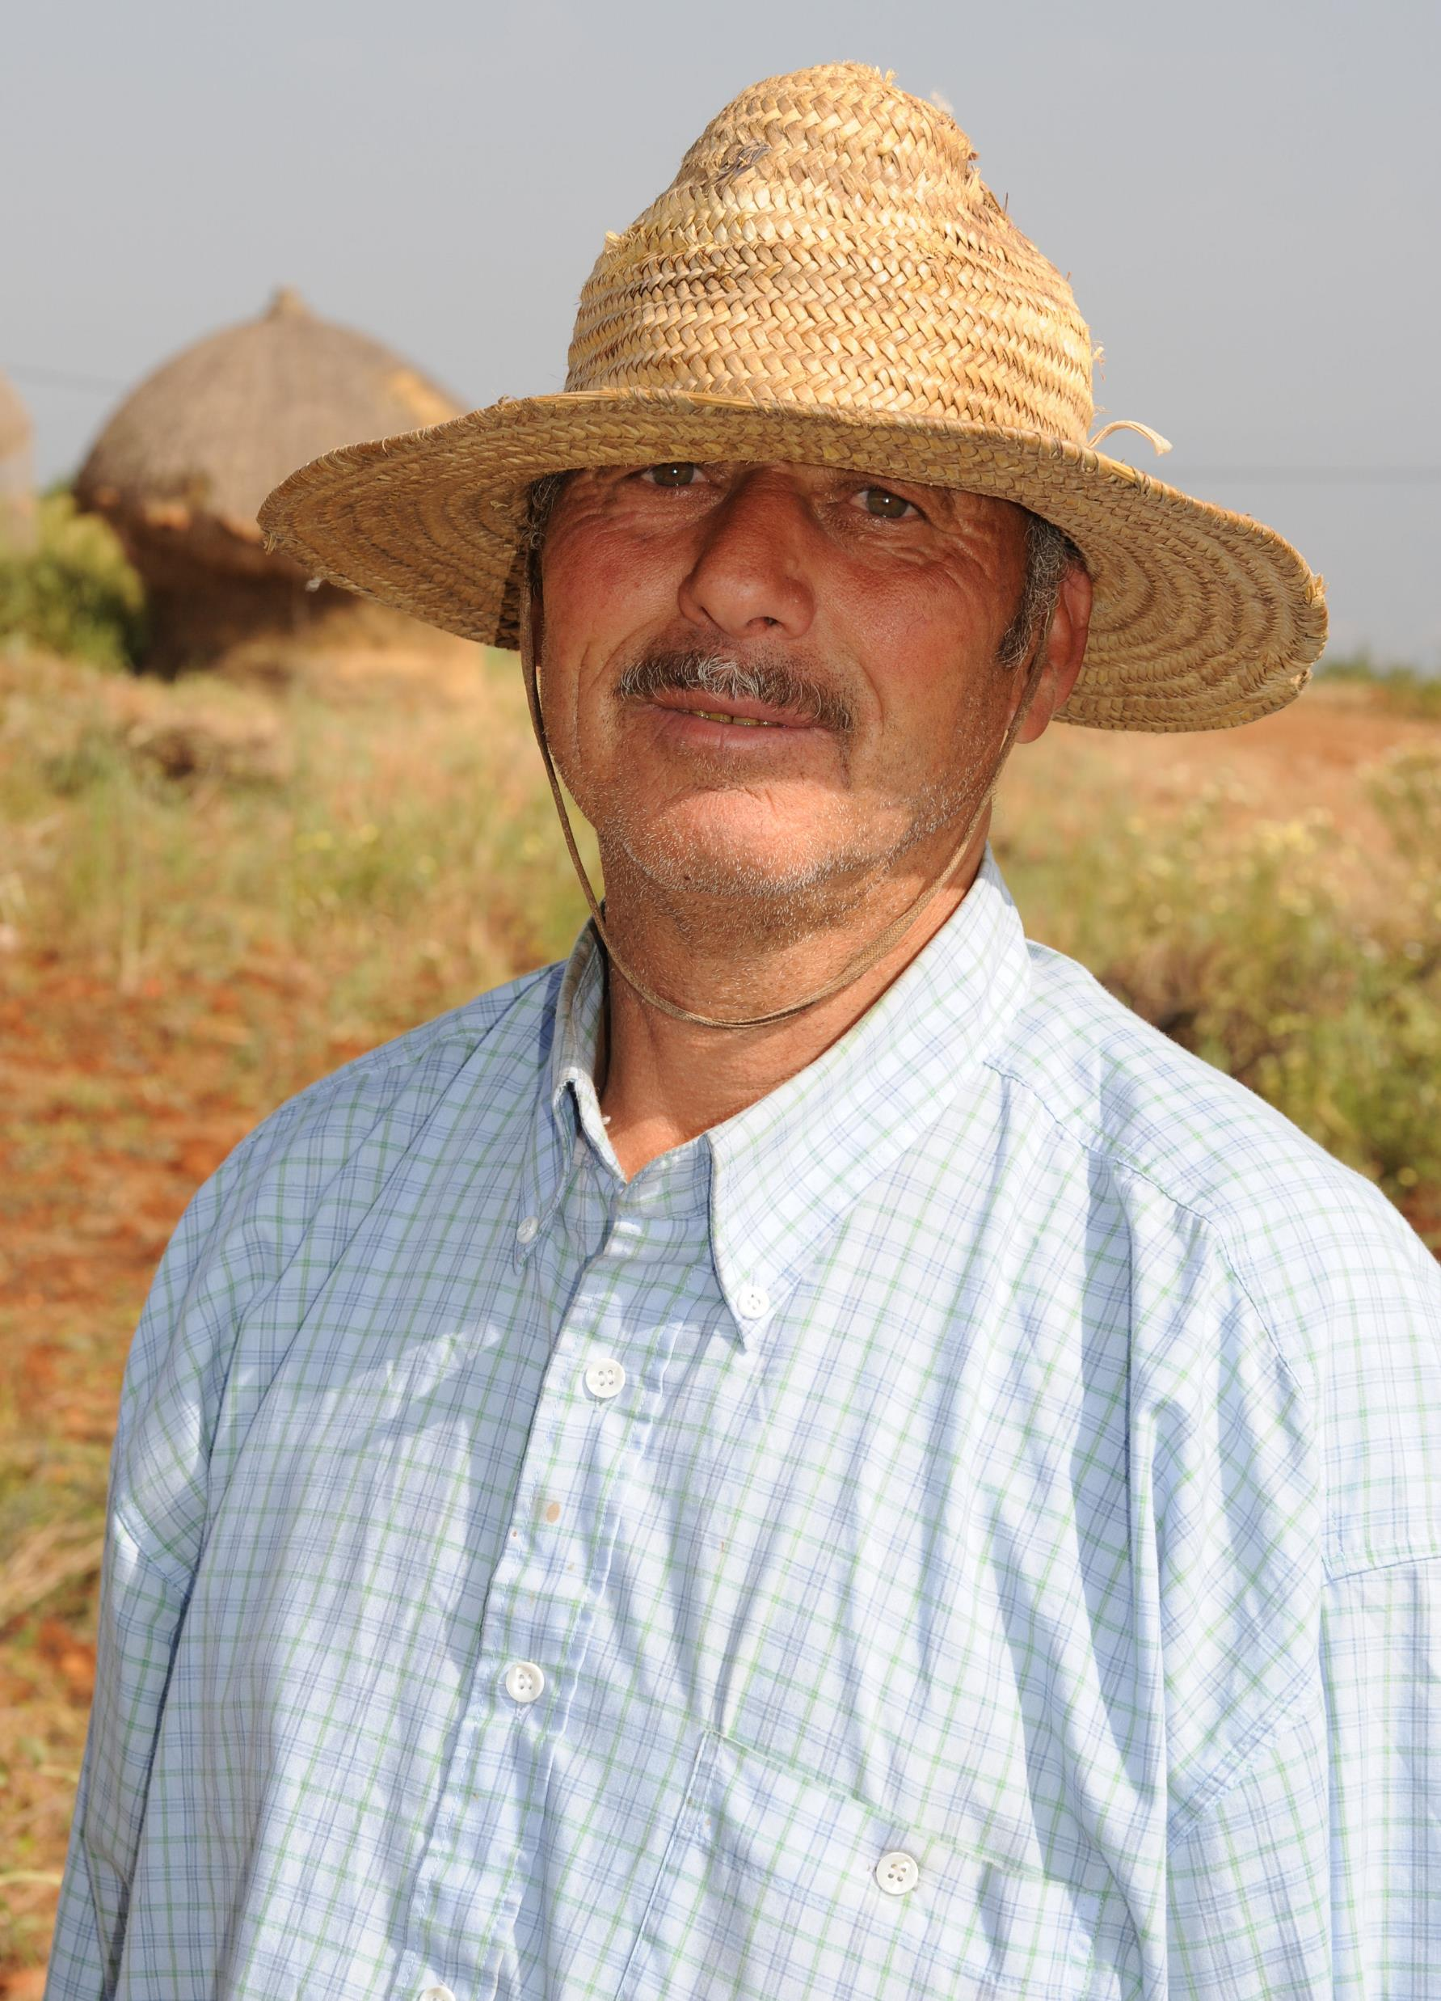
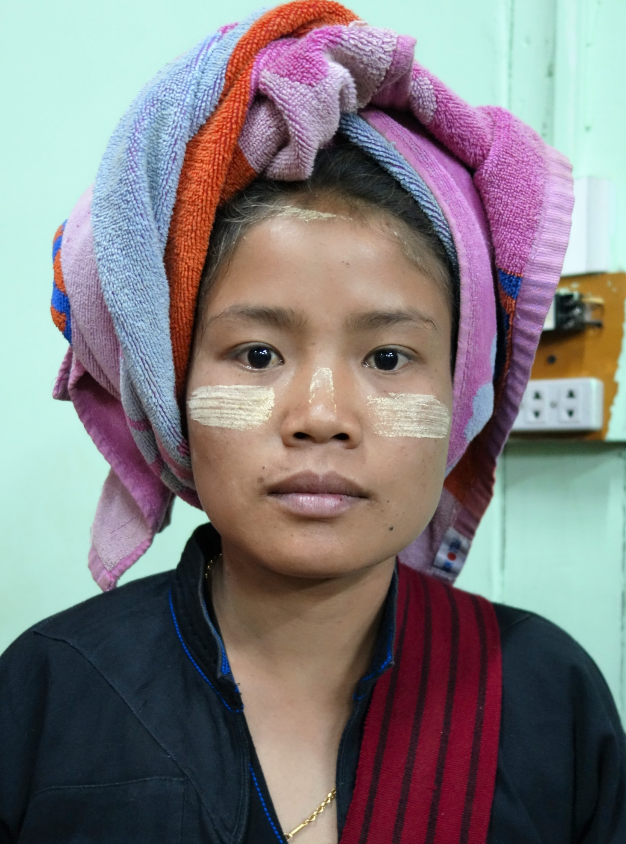
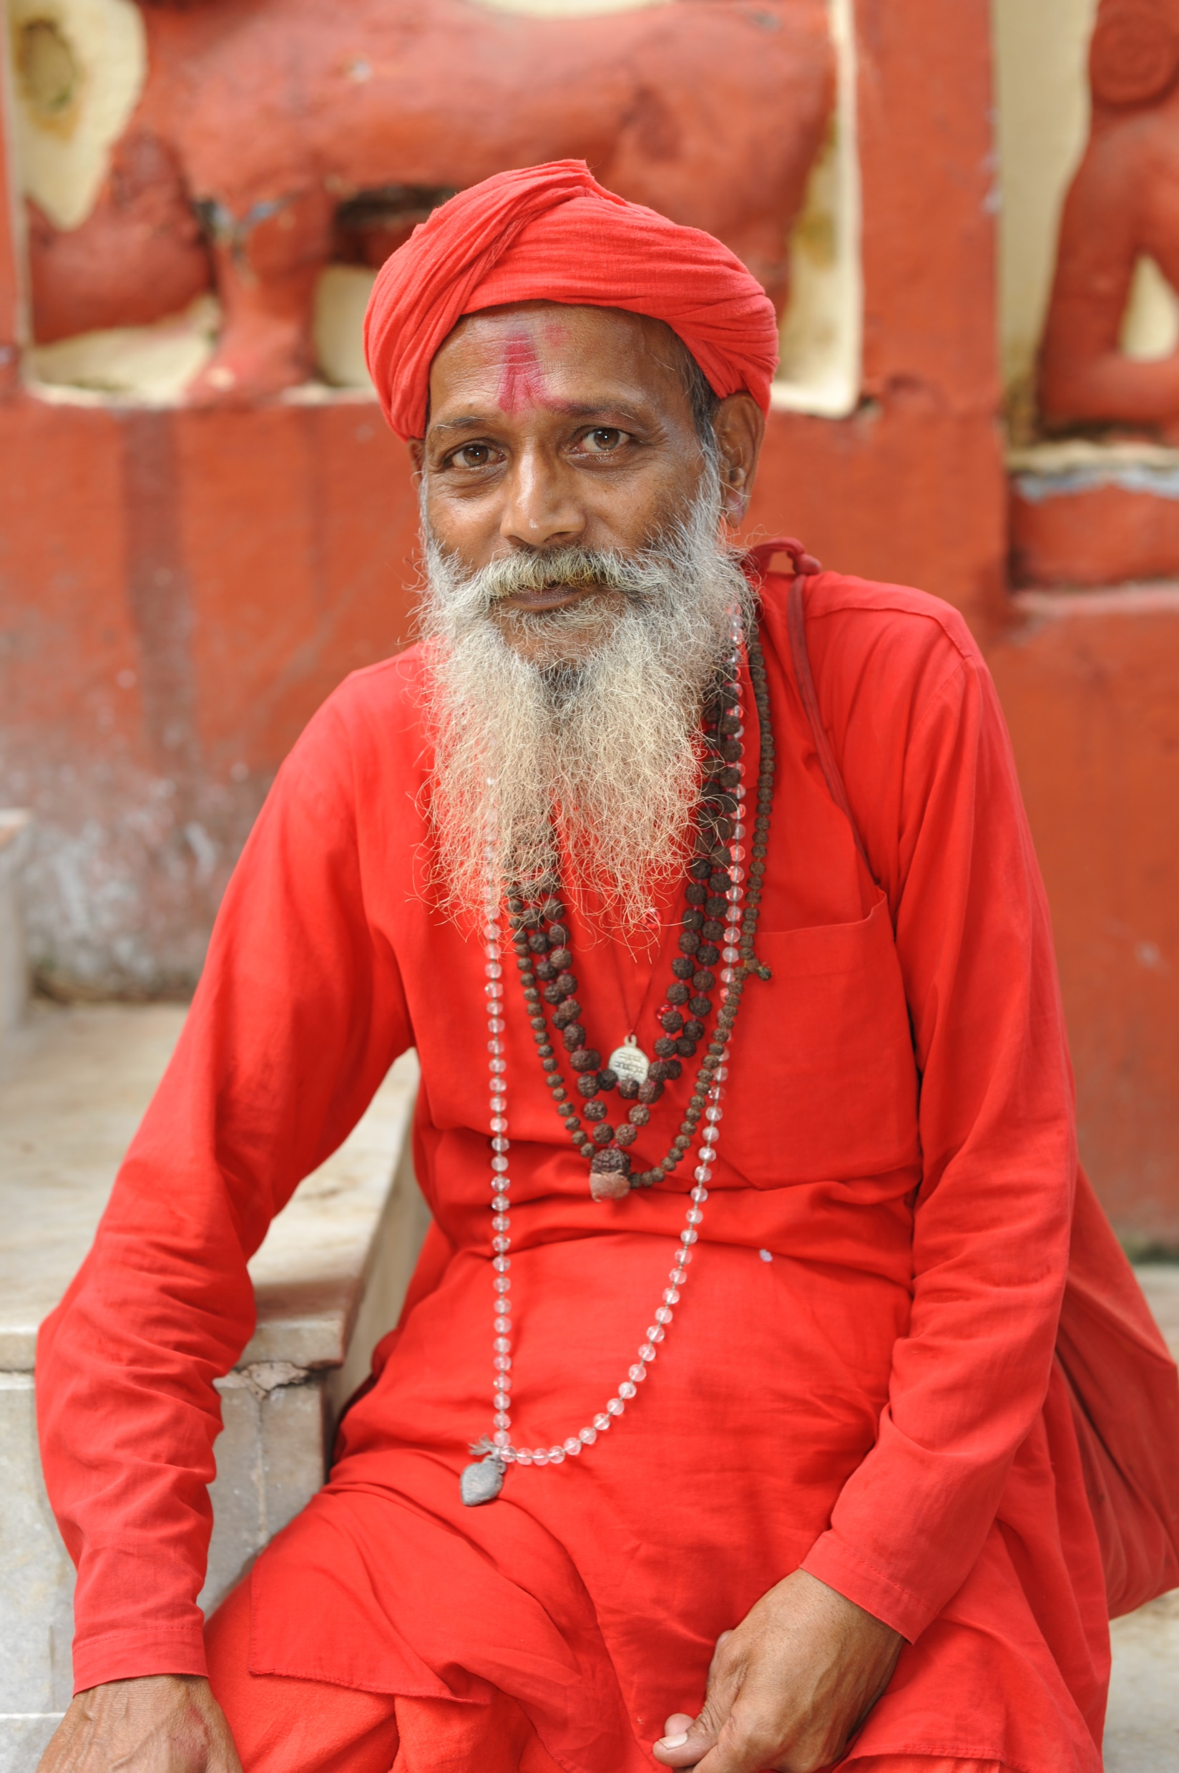
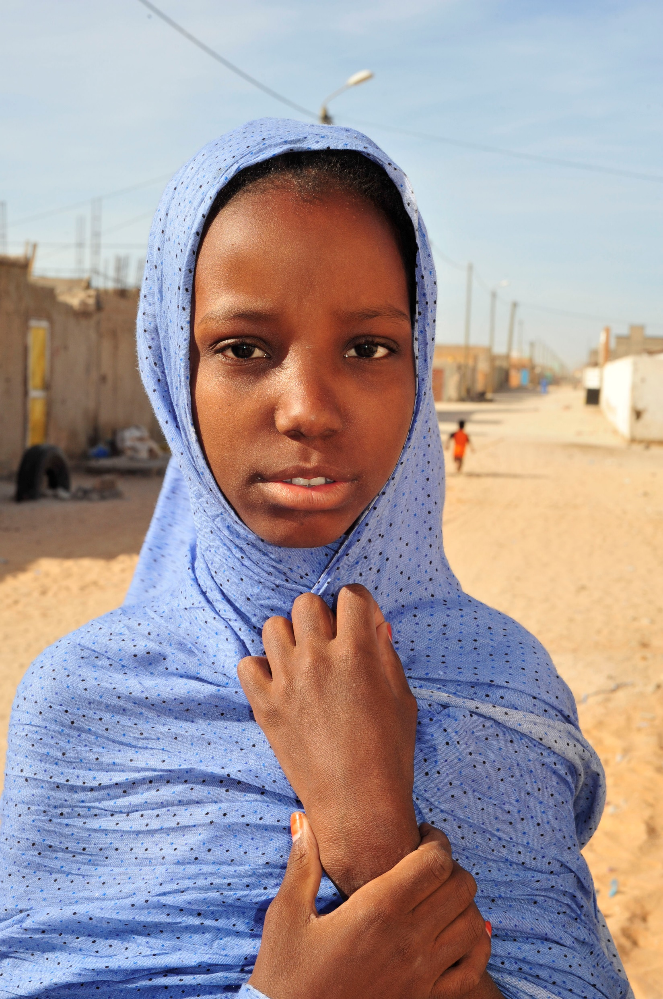

OF THE 573 ADOPTED & ENGAGED UPGS : 223 ARE FPGS
(FRONTIER PEOPLE GROUPS)

Slide 11

Who are
FRONTIER PEOPLE GROUPS?
An Unreached People Group (UPG)
with virtually no followers of Jesus and
no known movements to Jesus,
still needing pioneer cross-cultural workers.
0.1% or fewer Christian Adherents and no confirmed, sustained movement.
Who are Frontier Unreached People Groups?
A Frontier People Group (FPG) is:
an Unreached People Group (UPG)
with virtually no followers of Jesus and
no known movement to Jesus,
still needing pioneer cross-cultural workers.
0.1% or fewer Christian Adherents and no confirmed, sustained movement.

Slide 12
EMERGING MOVEMENTS ( STAGE 6A)

Slide 13

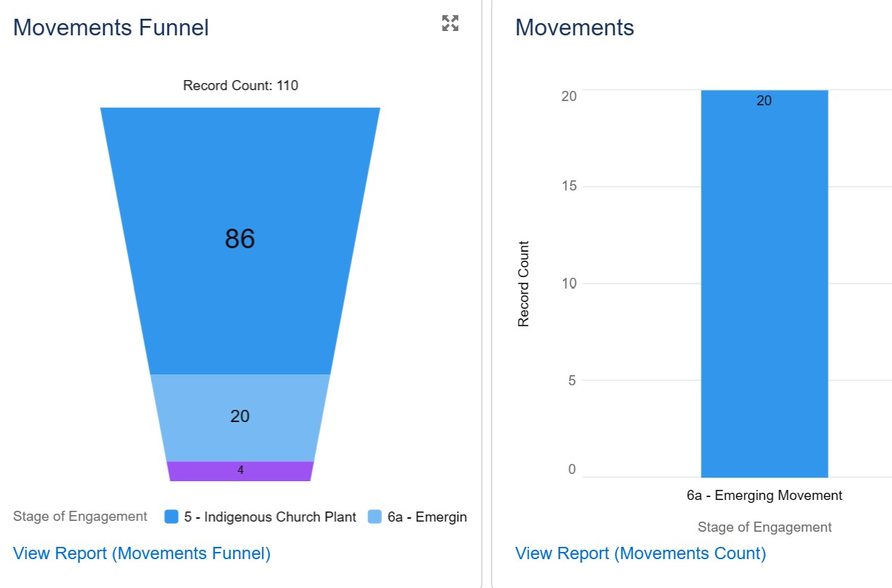
MOVEMENT TRACKING
Notes:
These are examples of what Sales Force can track and graph. The examples are historical, but going forward we need to track breakthrough, emerging and sustainable movements, as well as PRE MOVEMENTS… Those UPGS that we anticipate rapid growth birthed out of DBSs. / church planting efforts.
Example: Sam in Ghana: 5 UPGs identified,

Slide 14
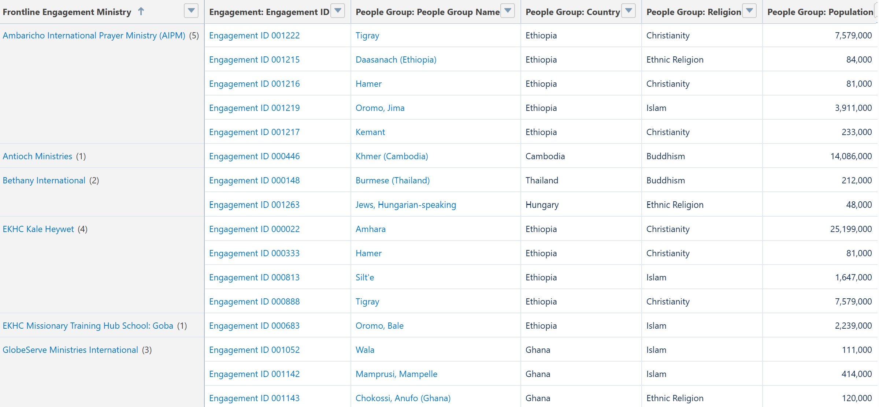
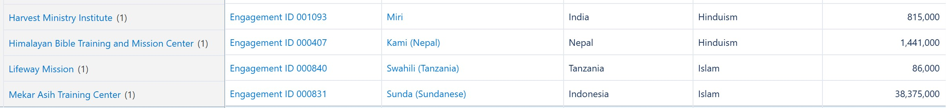
Notes:
20 Emerging Movements at Stage 6A

Slide 15
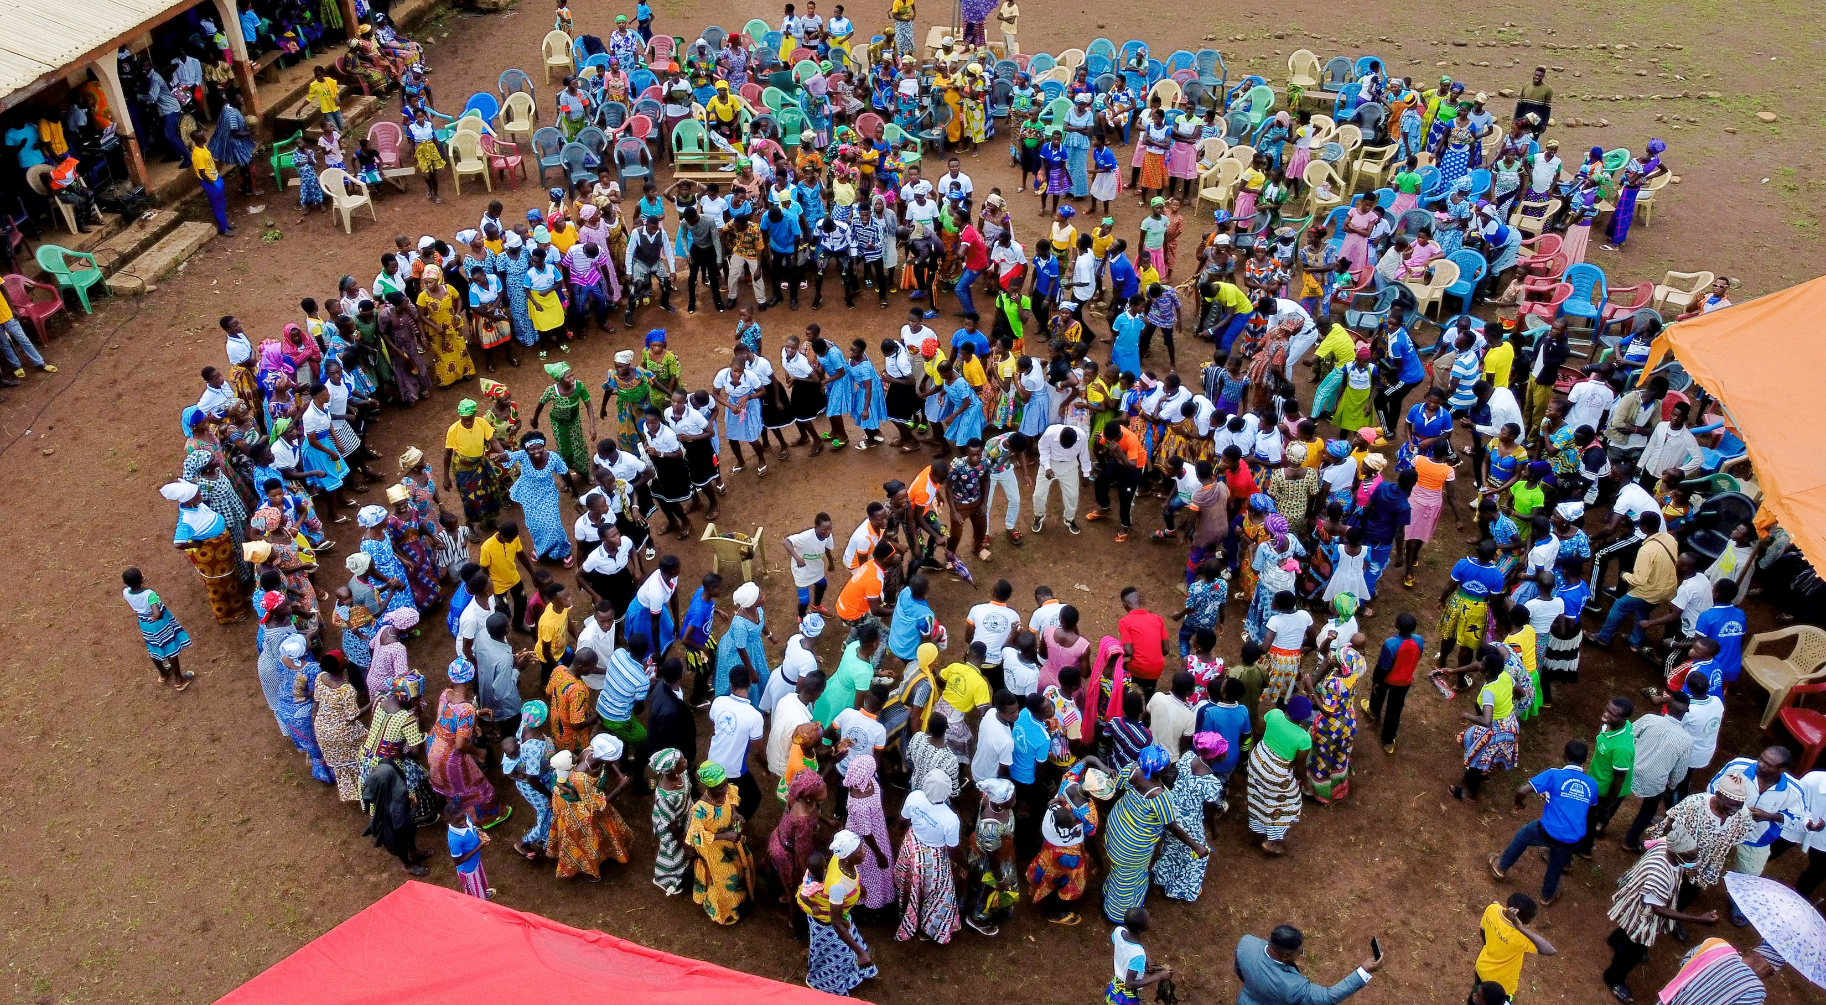
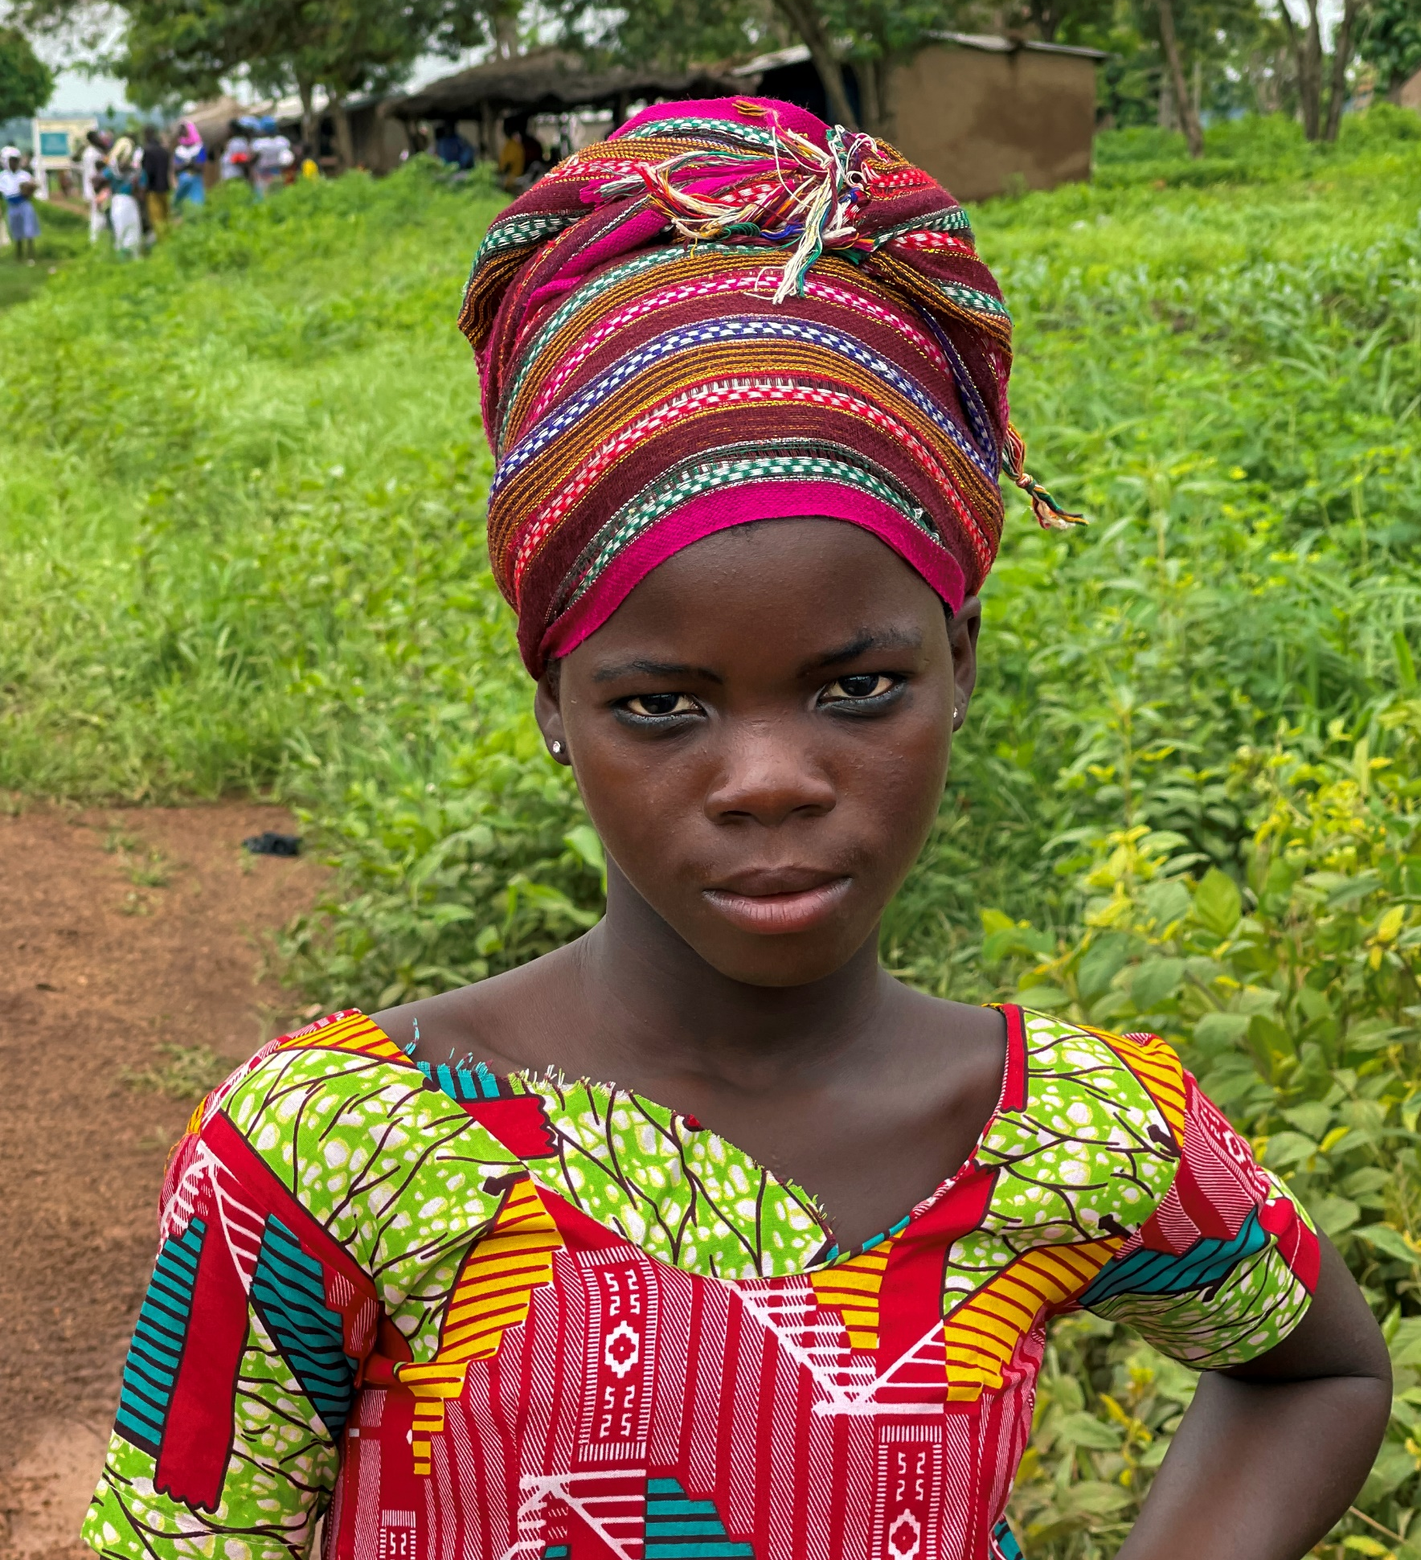
AN EMERGING MOVEMENT AMONG THE
CHOKOSI (TCHOKOSSI, ANUFO) OF GHANA

Slide 16
OBSERVABLE TRENDS:
1. INDIA’S STRONG ROLE IN UPG ENGAGEMENTS & MOVEMENT POTETNTIAL.
2. THE GROWING PARTICIPATION OF NEW HUBS IN ADOPTIONS & ENGAGEMENTS.
3. HIGH ADOPTIONS AMONG MUSLIM UPGS, BUT FEWER MOVING TO STAGES 4 AND ABOVE.
4. HIGH ENGAGEMENT AMONG HINDU UPGS.
5. IDENTIFICATION OF AND COMITTMENT TO UPGS POISED TO BECOME MOVEMENTS.

Slide 17
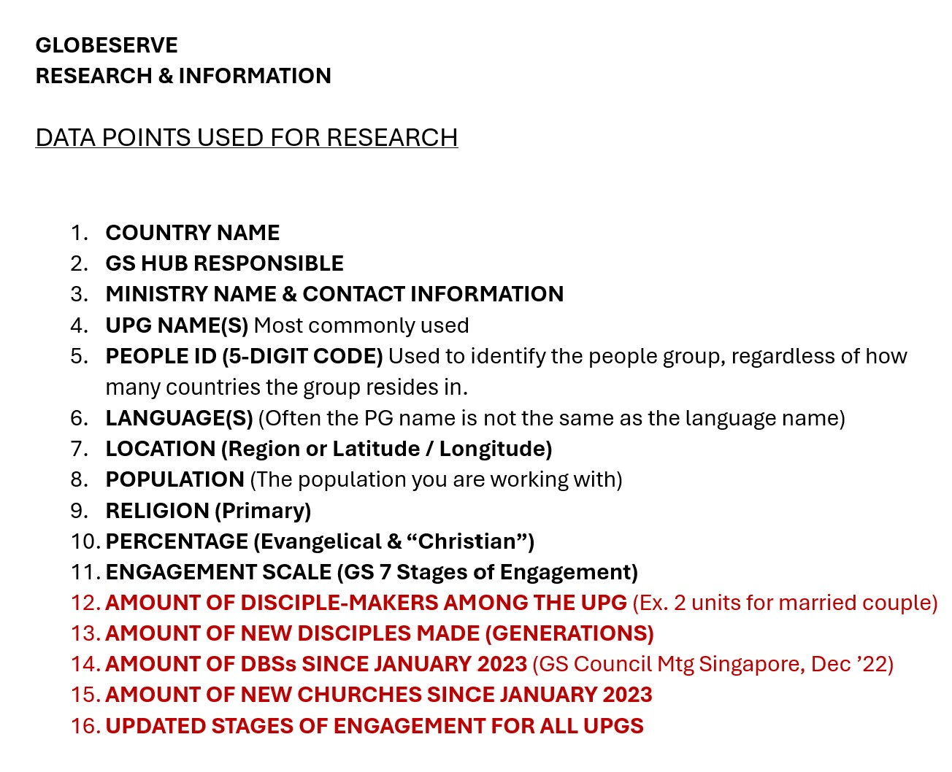
DATA POINTS
GOING FORWARD…

Slide 18
RESEARCH & INFORMATION

